Slide 1
Tool Installation

Slide 2
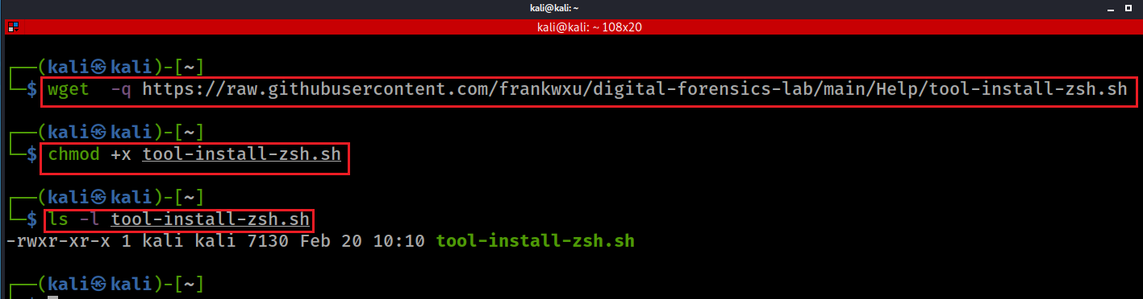
Notes:
wget https://raw.githubusercontent.com/frankwxu/digital-forensics-lab/main/Help/tool-install-zsh.sh
chmod +x tool-install-zsh.sh
ls -l tool-install-zsh.sh

Slide 3
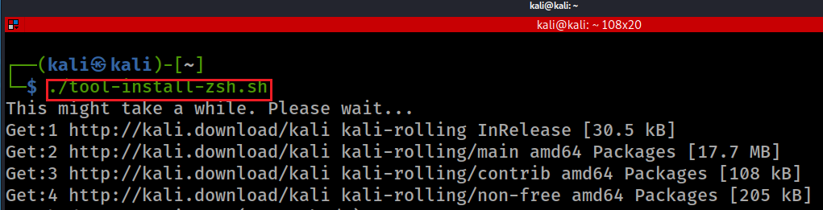
Notes:
./tool-install-zsh.sh

