Slide 1
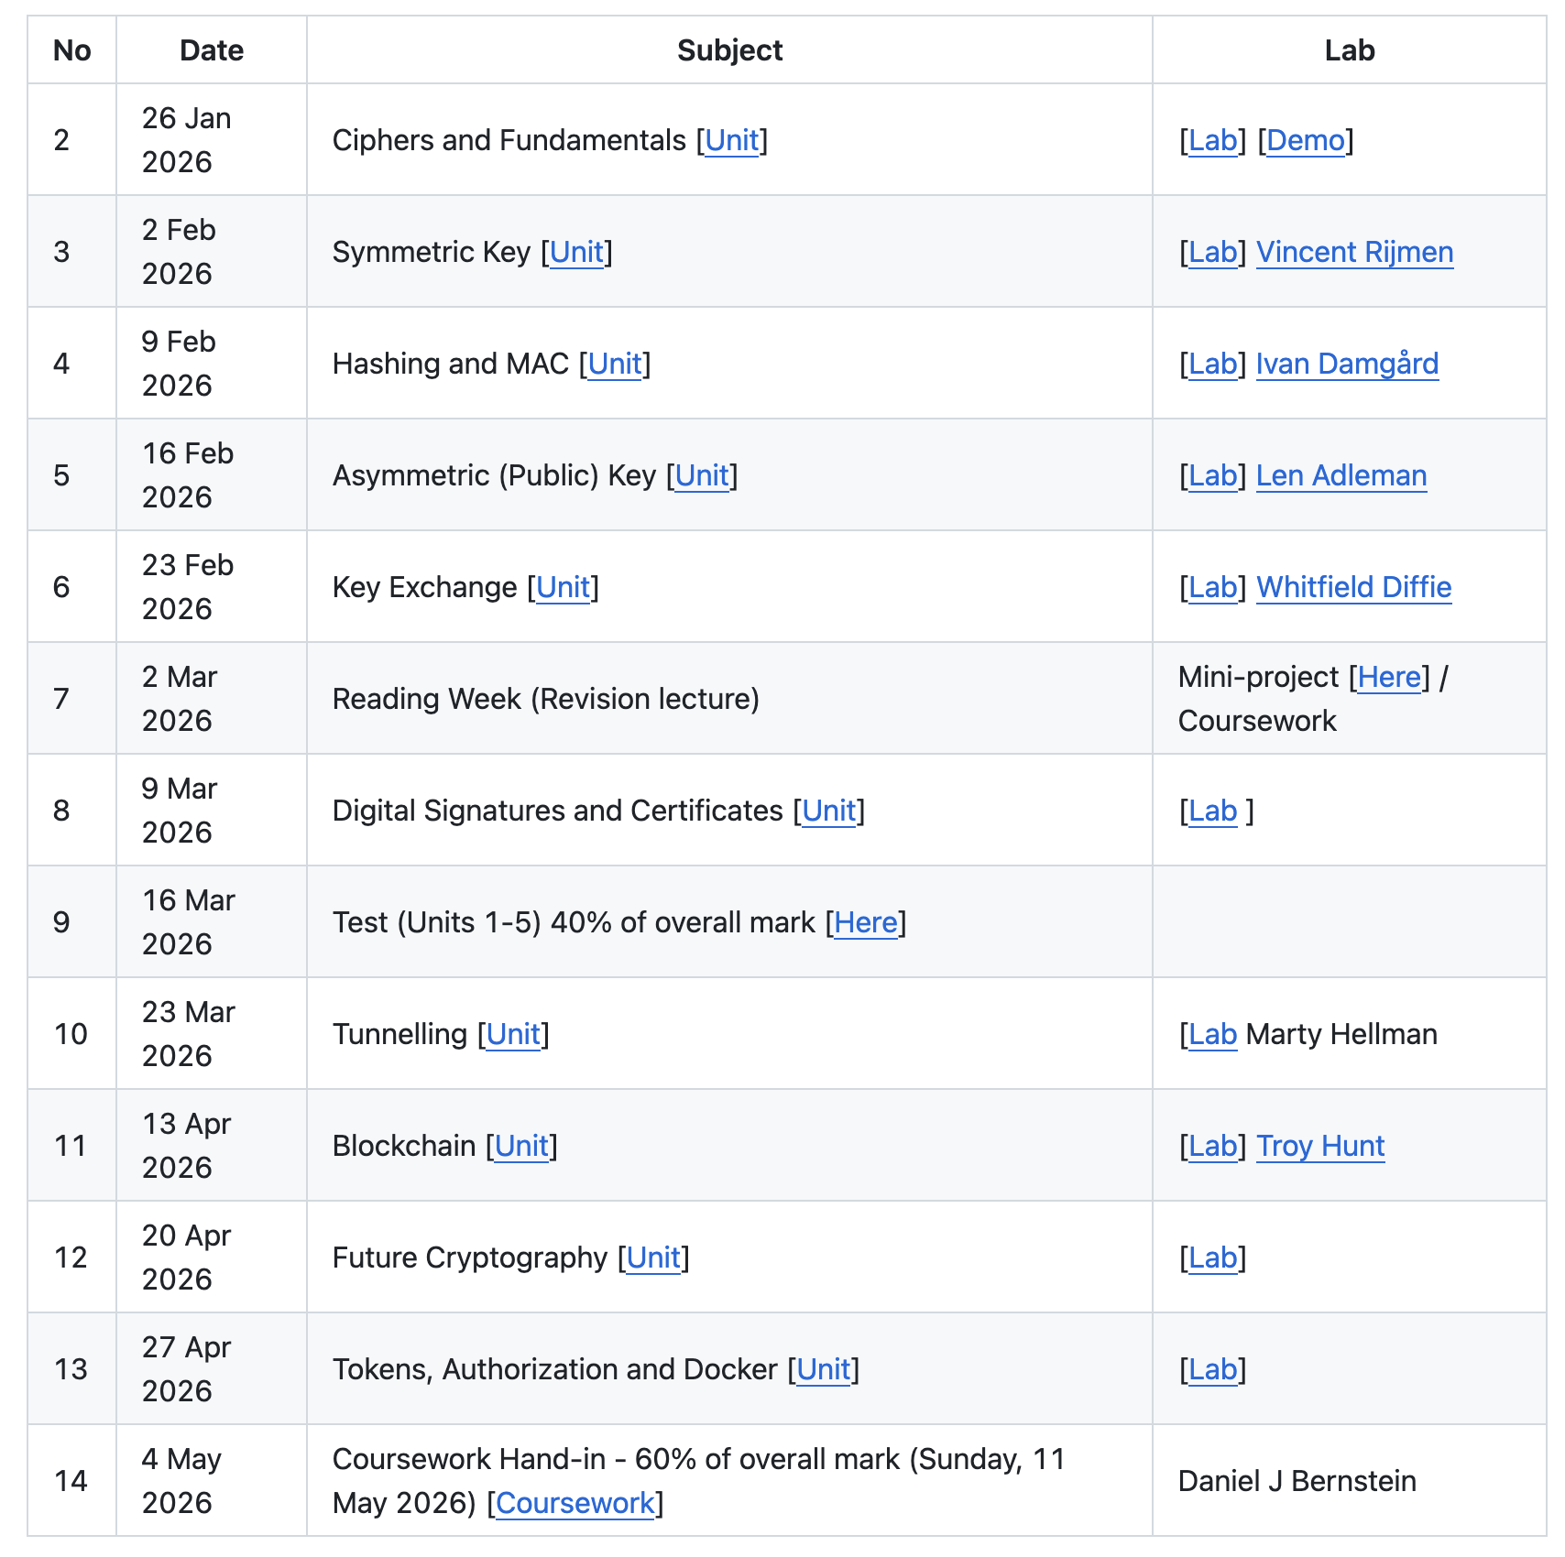
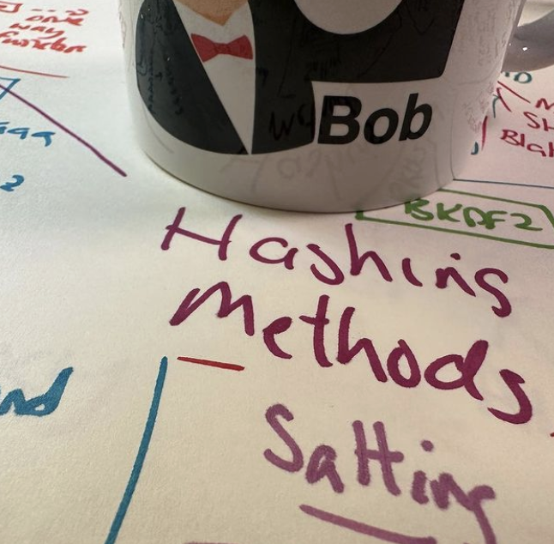
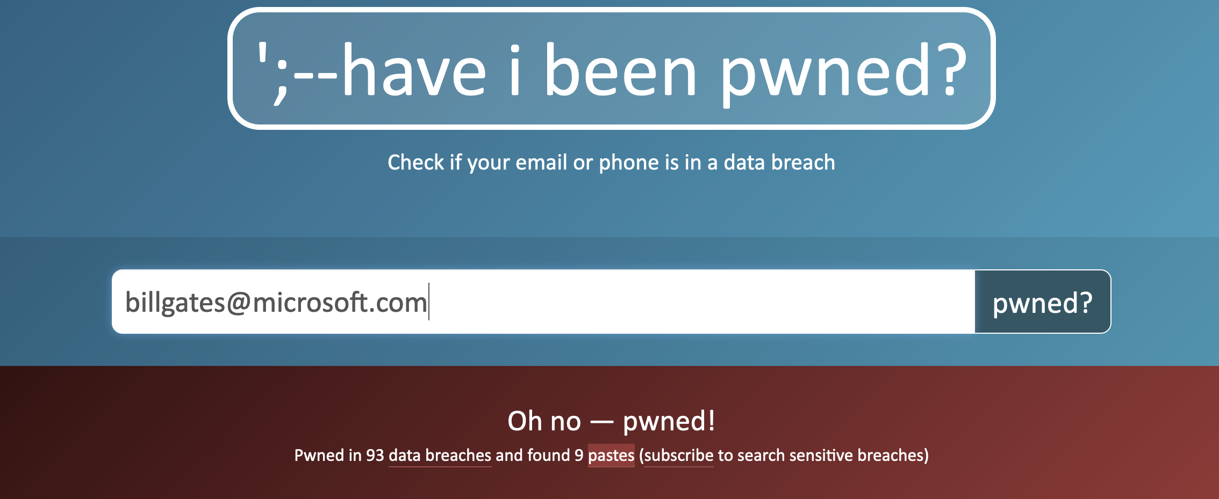
Unit 3: Hashing
Hashing Types.
Hashing Methods.
Salting.
Collisions.
LM and NTLM Hashes (Windows).
Hash Benchmarks.
Message Authentication Codes (MACs).
Key Derivation Function (KDF)
OTP/HOTP.
Hashcat (for practical work)
Prof Bill Buchanan OBE https://asecuritysite.com/hash

Slide 2
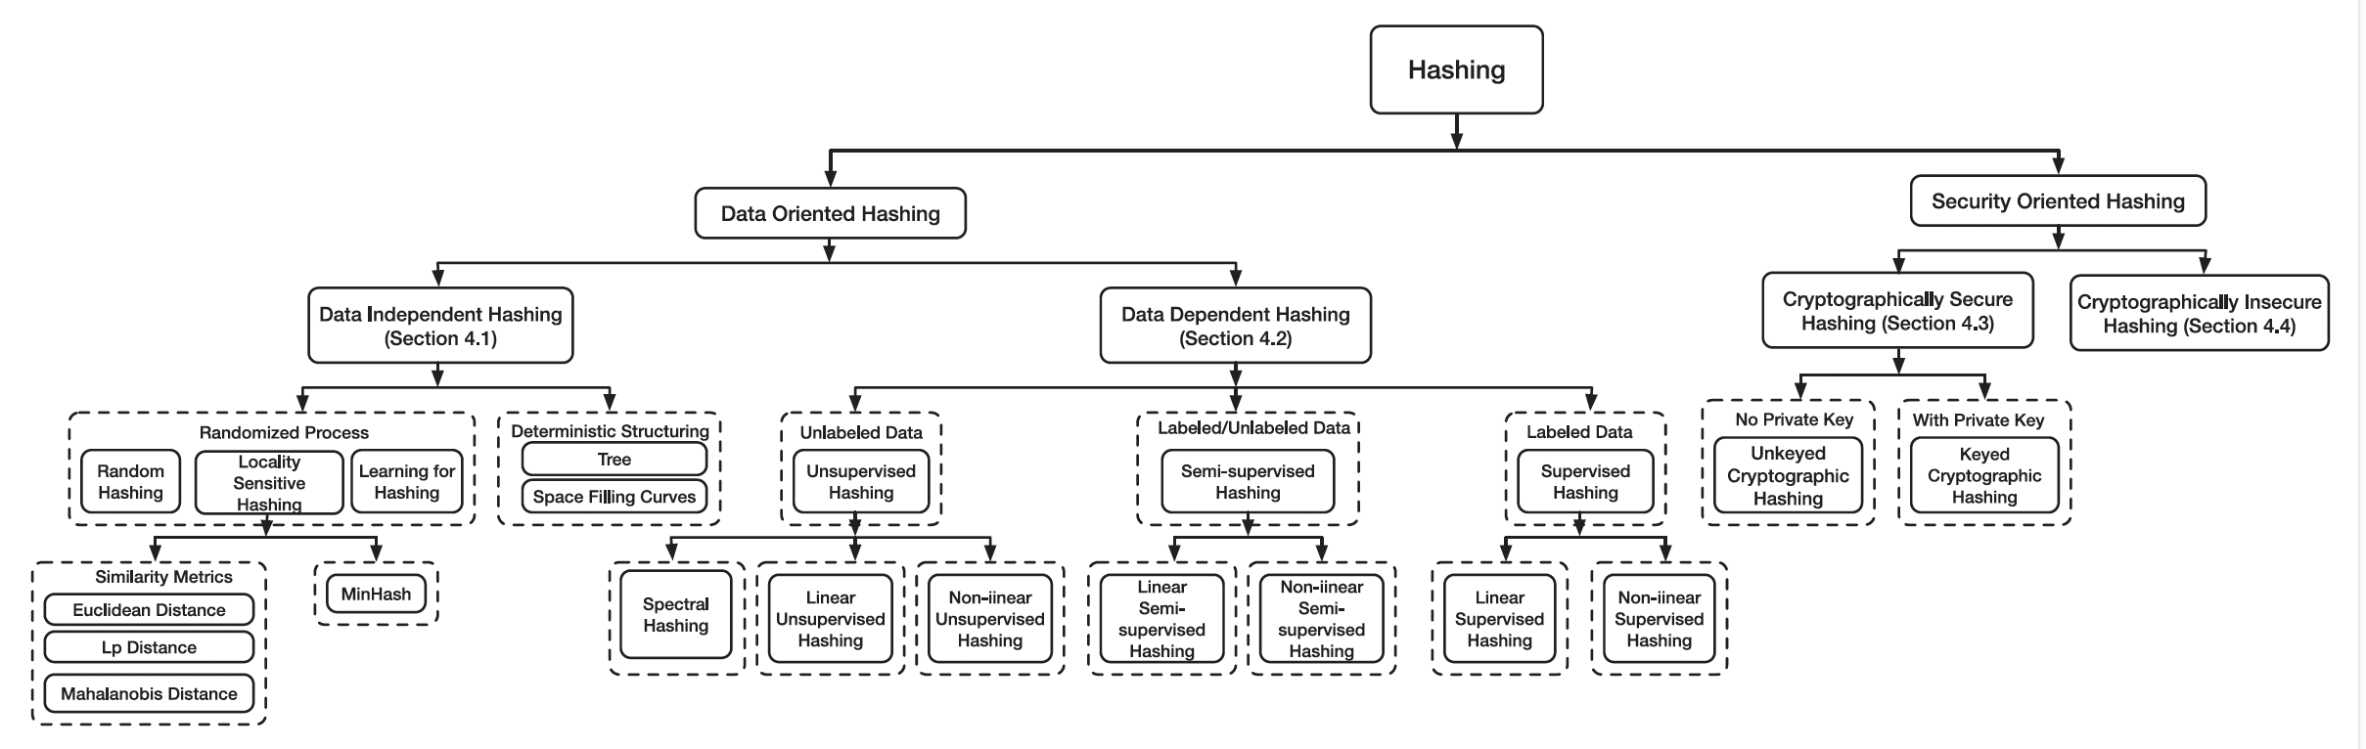
Unit 3: Hashing
Hashing Types.
Hashing Methods.
Salting.
Collisions.
LM and NTLM Hashes (Windows).
Hash Benchmarks.
Message Authentication Codes (MACs).
Key Derivation Function (KDF).
OTP/HOTP.
Hashcat (for practical work)
Prof Bill Buchanan OBE https://asecuritysite.com/hash

Slide 3
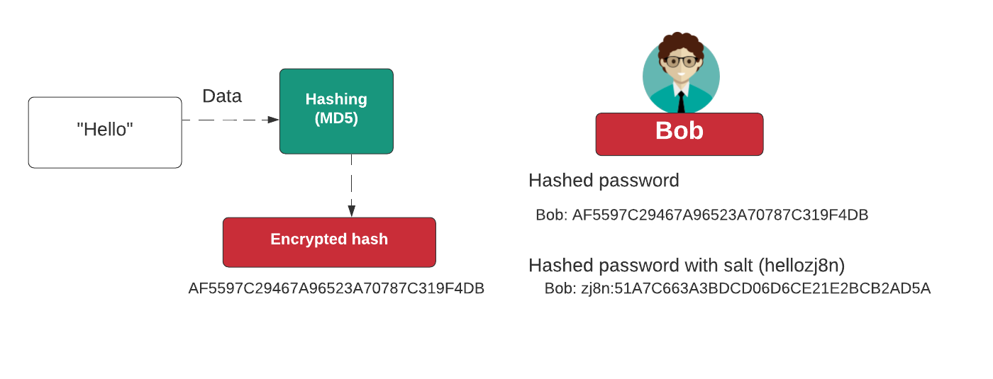
Hashing
Cryptographic Hashes: MD5, SHA-1, SHA-256, SHA-3, RIPEMD, Blake2b
Windows hashes: NTLM
Non-cryptographic hashes: Spooky, Farm, FVN
https://asecuritysite.com/golang/gohash

Slide 4
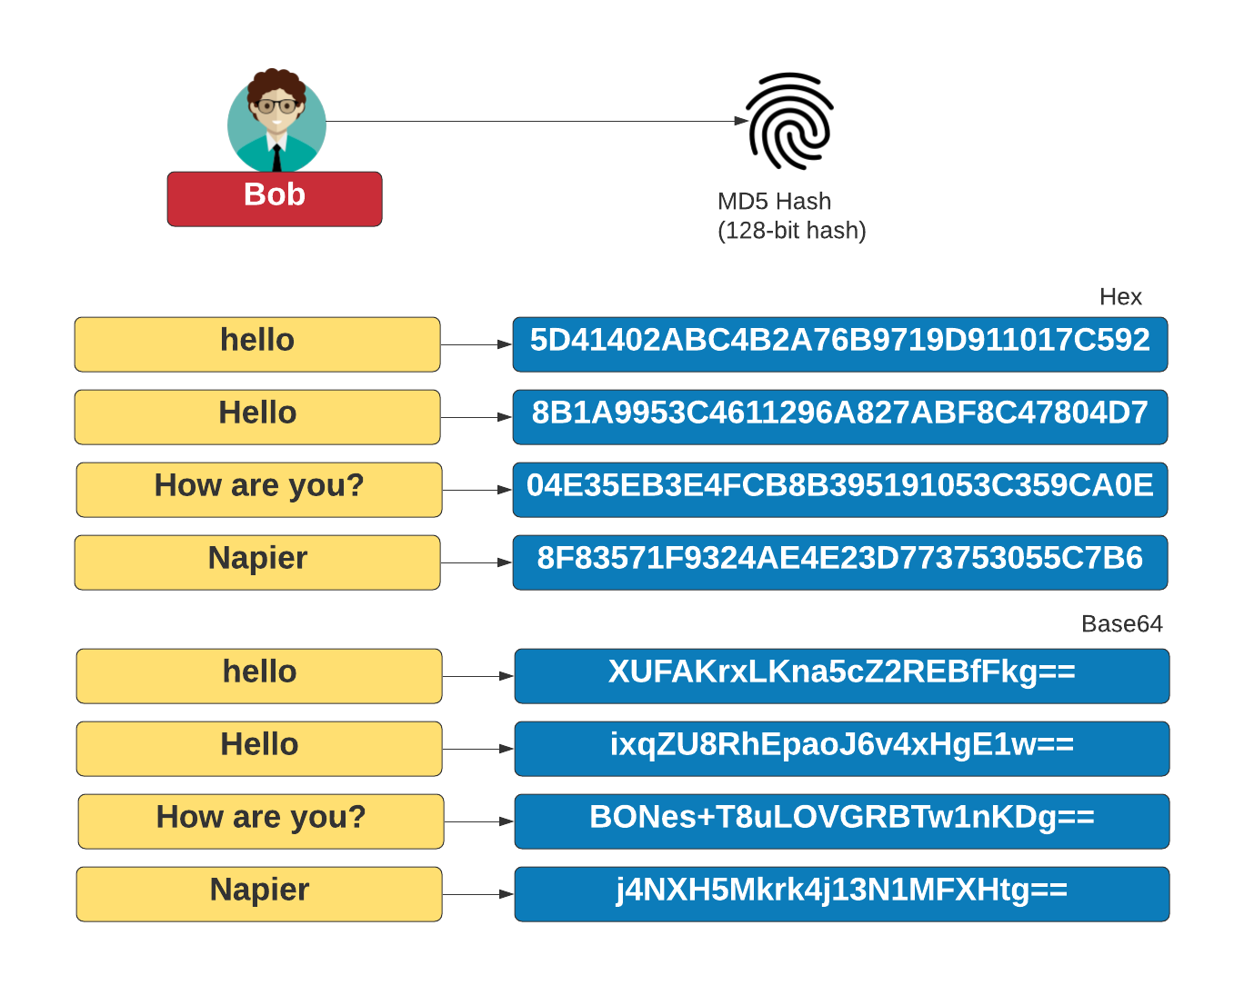

Slide 5
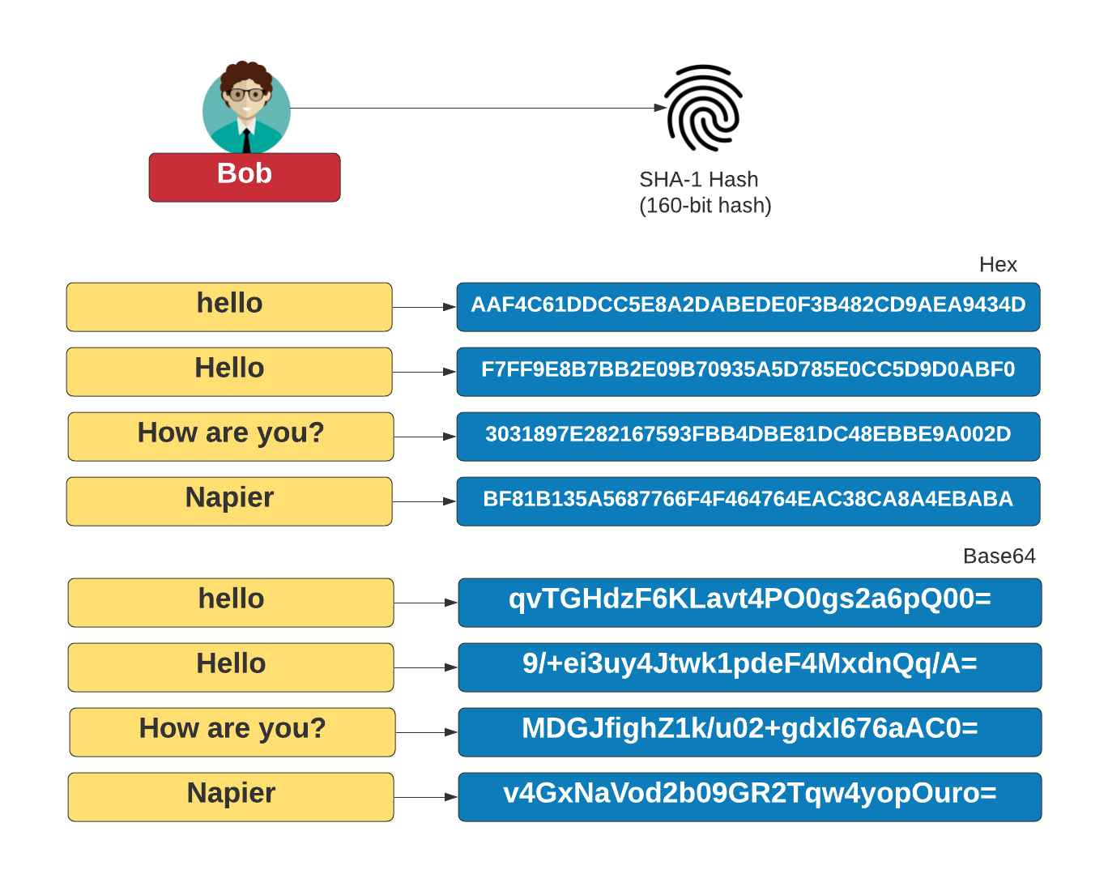

Slide 6
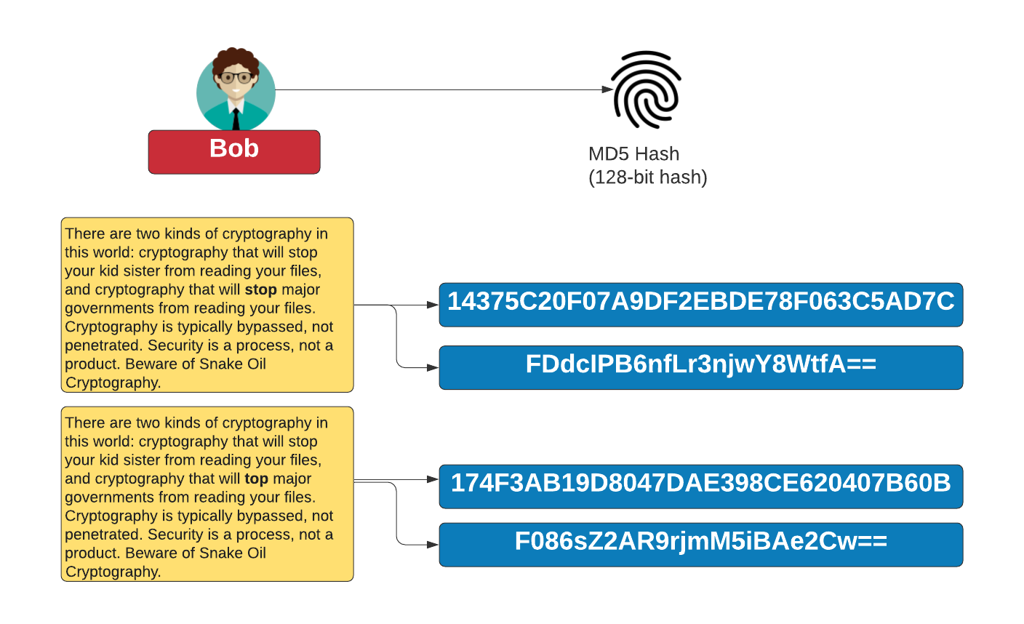

Slide 7
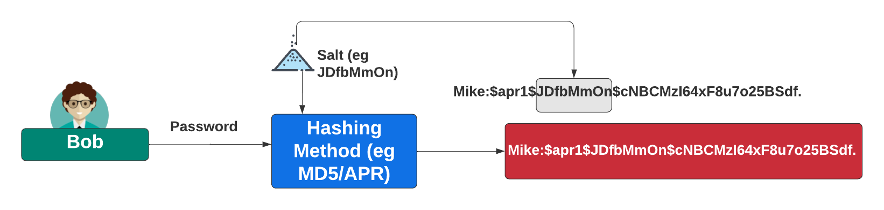
Adding Salt
https://asecuritysite.com/hash/salt

Slide 8
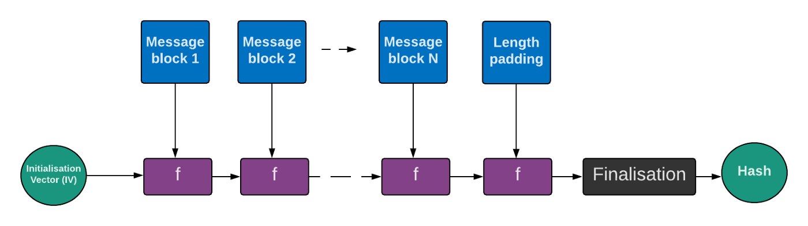
Merkle-Damgård (MD) construction
https://asecuritysite.com/hash/lenattack

Slide 9
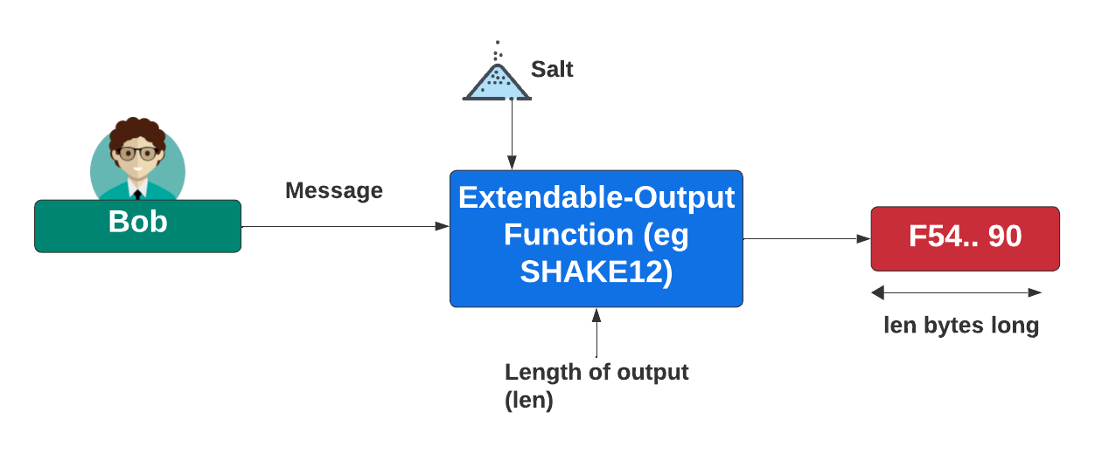
XOF
https://asecuritysite.com/hash/cs

Slide 10
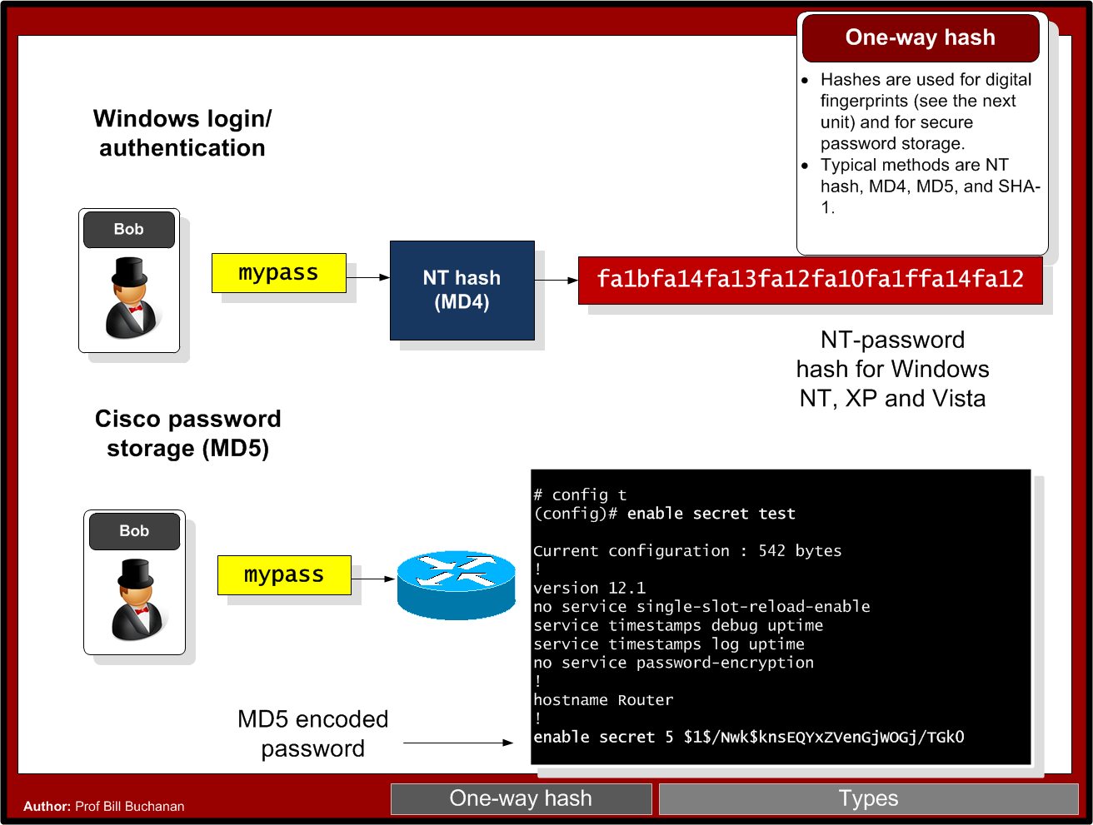

Slide 11
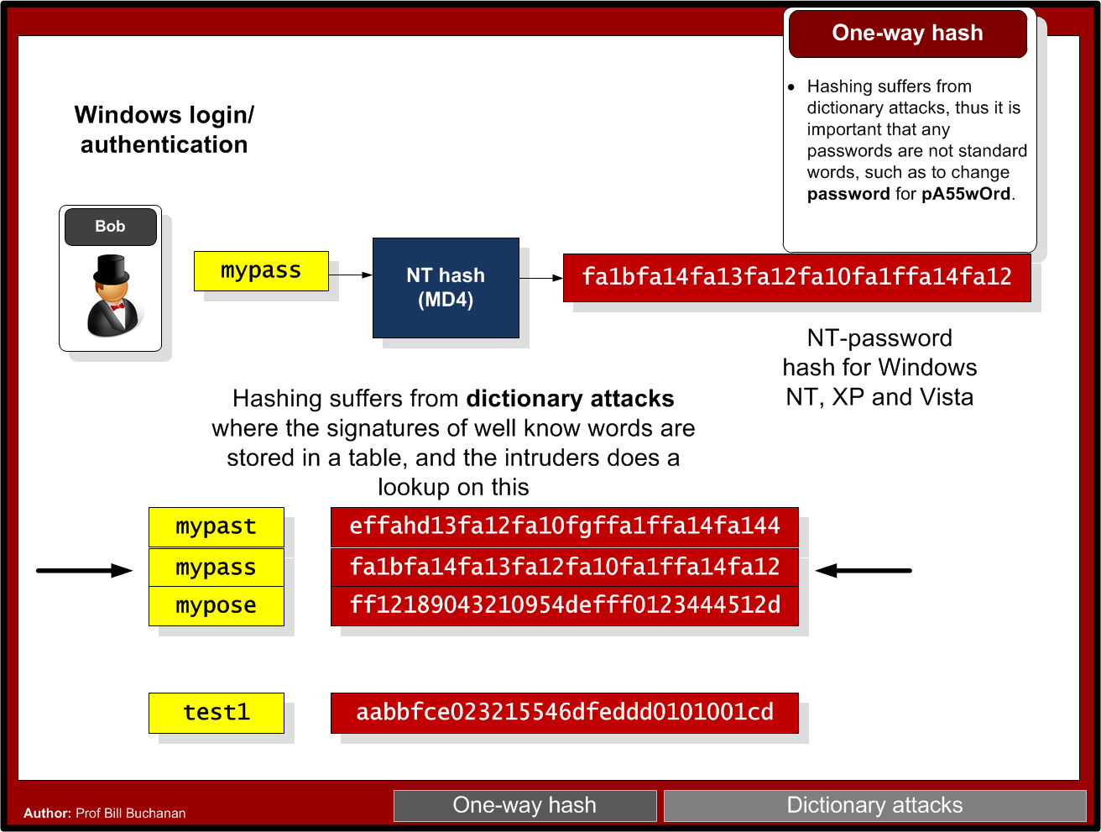

Slide 12
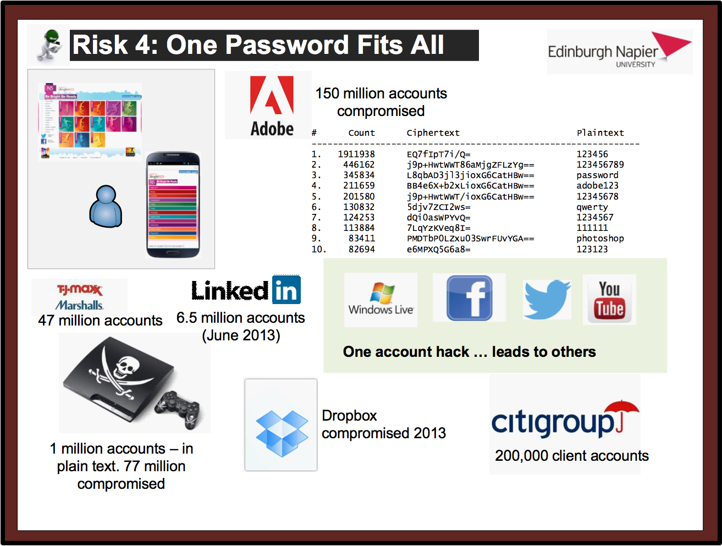

Slide 13
Brute Force - How many hash codes?
7 digit password with [a-z] … how many?
    Ans:
    Time to crack - 100 billion per second:
7 digit with [a-zA-z] … how many?
    Ans:
    Time to crack – 100 billion per second:
7 digit with [a-zA-z!@#$%^&*()] … how many?
    Ans:
    Time to crack – 100 billion per second:

Slide 14
Unit 3: Hashing
Hashing Types.
Hashing Methods.
Salting.
Collisions.
LM and NTLM Hashes (Windows).
Hash Benchmarks.
Message Authentication Codes (MACs).
Key Derivation Function (KDF).
OTP/HOTP.
Hashcat
Prof Bill Buchanan OBE https://asecuritysite.com/hash

Slide 15
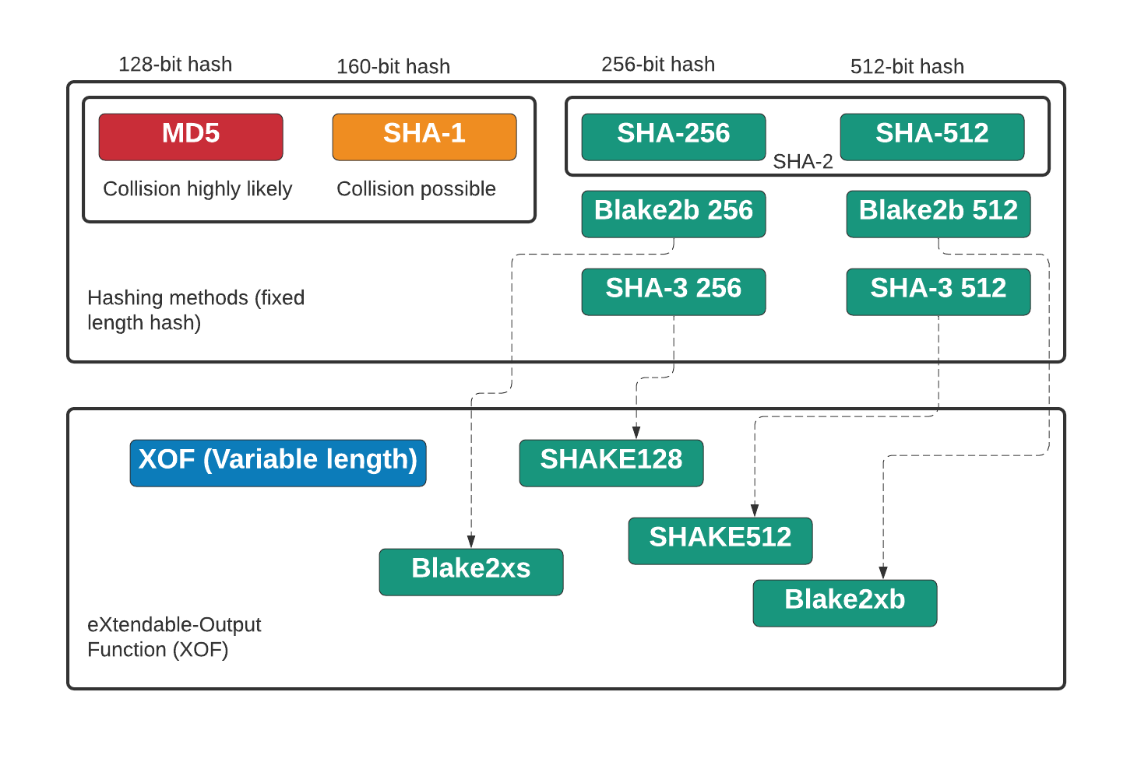

Slide 16
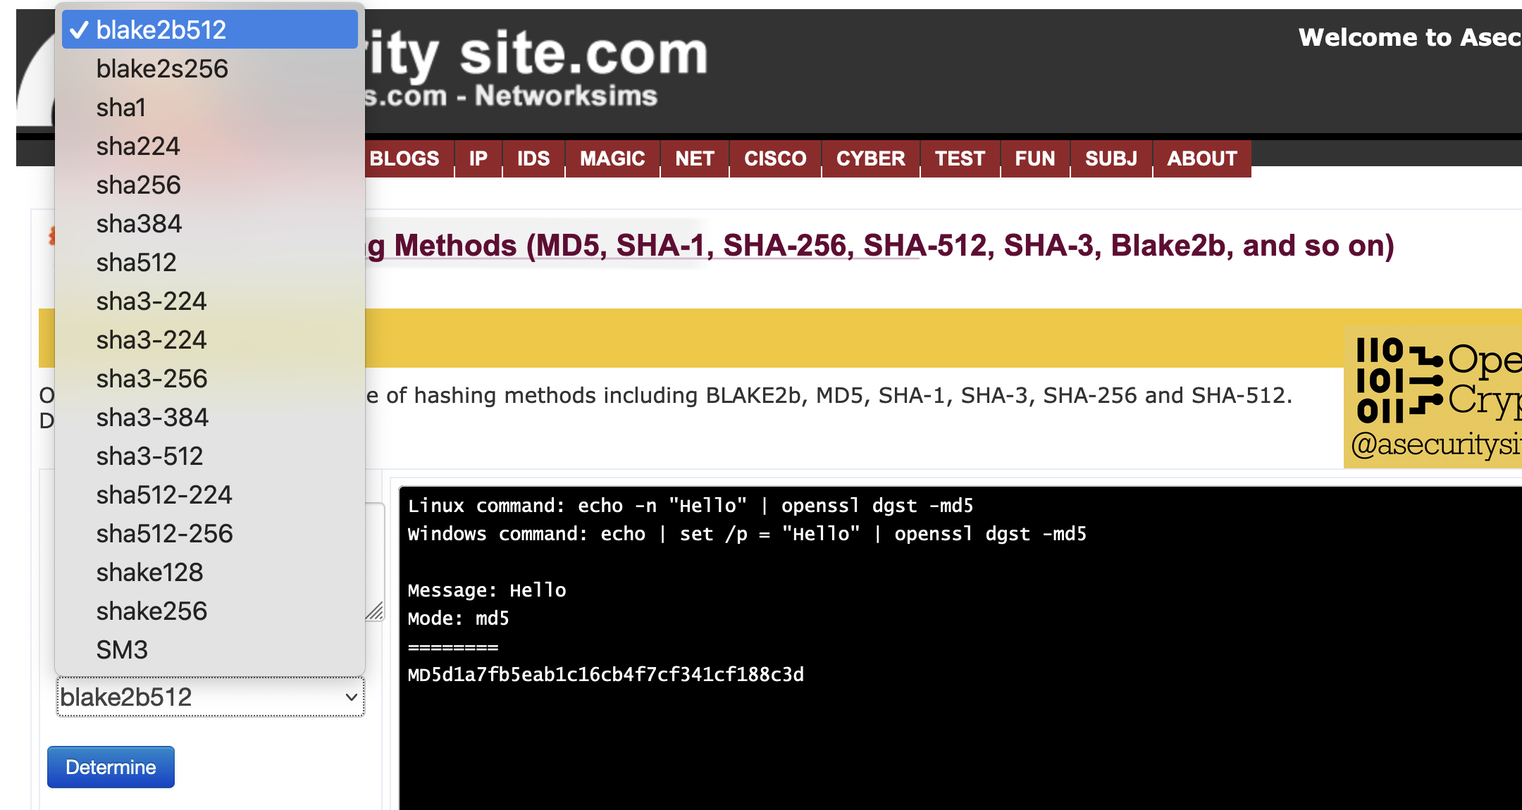
OpenSSL
https://asecuritysite.com/openssl/openssl_full2
https://asecuritysite.com/webcrypto/crypt_hash

Slide 17
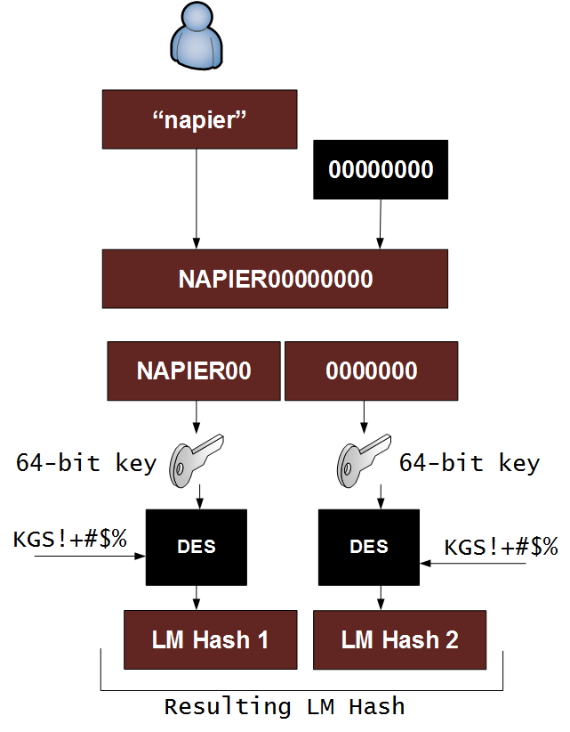
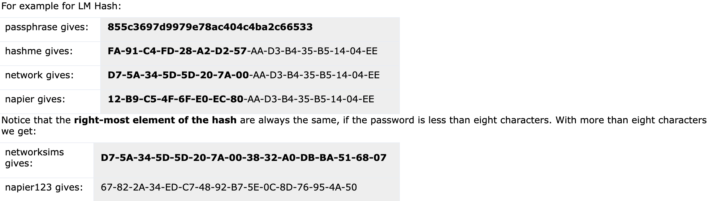
LM and NTLM
https://asecuritysite.com/hash/lmhash

Slide 18
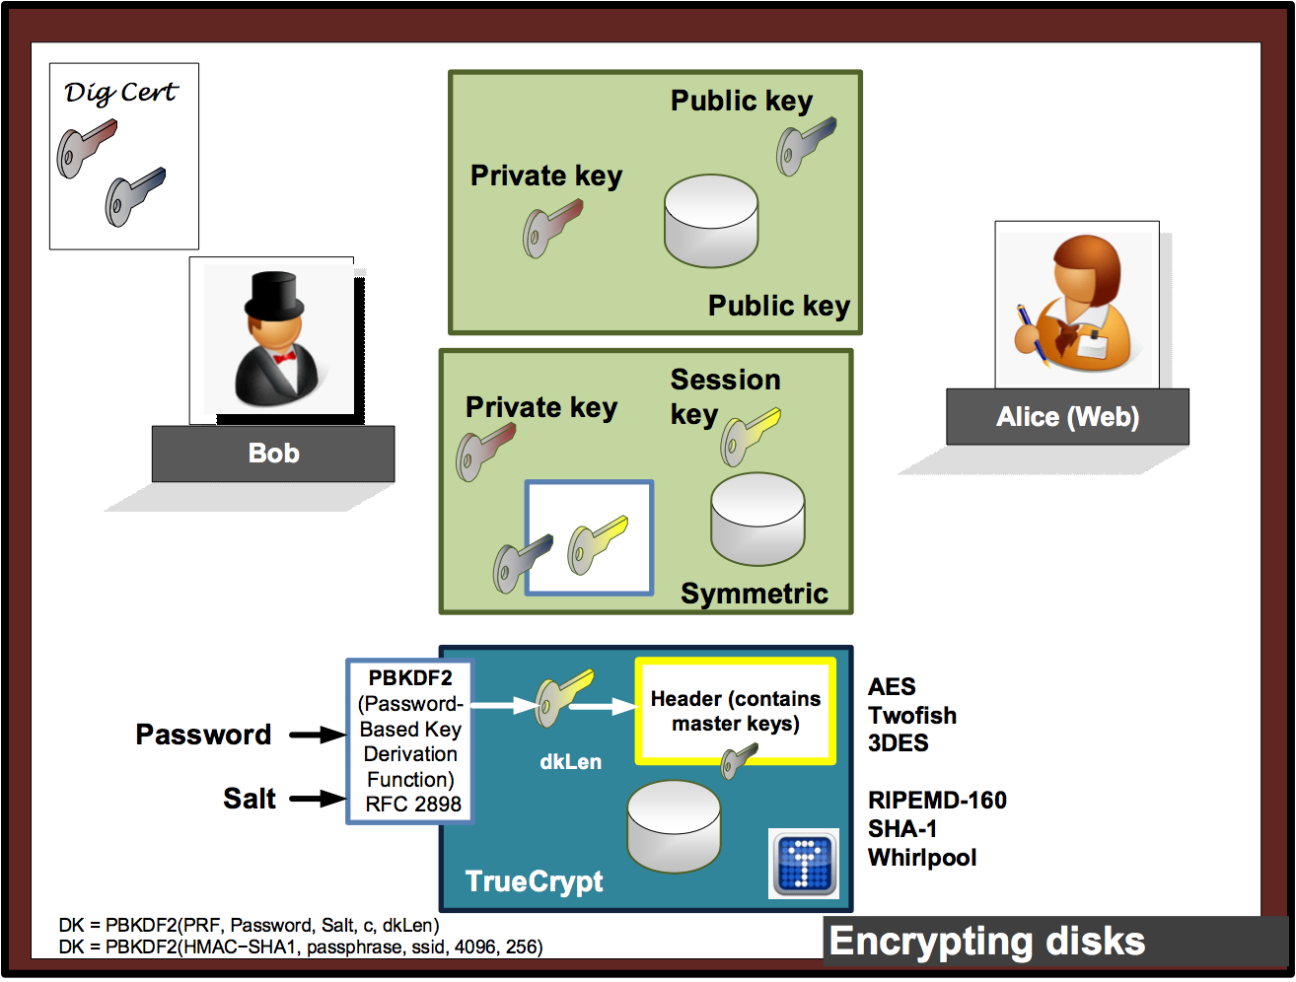

Slide 19
Unit 3: Hashing
Hashing Types.
Hashing Methods.
Salting.
Collisions.
LM and NTLM Hashes (Windows).
Hash Benchmarks.
Message Authentication Codes (MACs).
Key Derivation Function (KDF)
OTP/HOTP.
Secret Shares.
Prof Bill Buchanan OBE http://asecuritysite.com/crypto03 http://asecuritysite.com/encryption

Slide 20
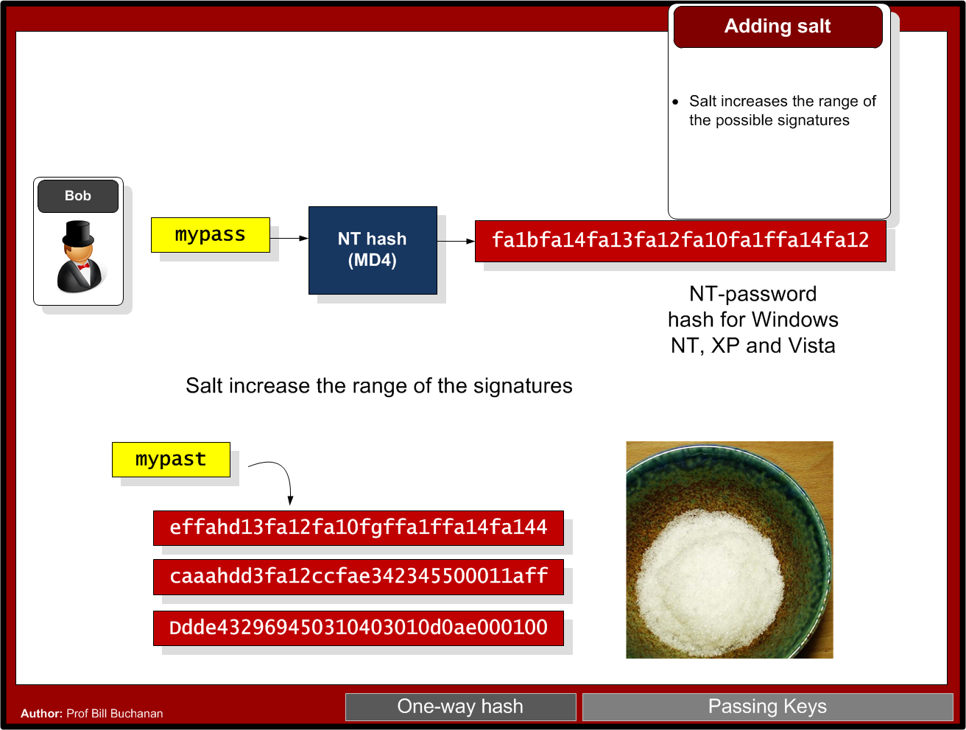

Slide 21
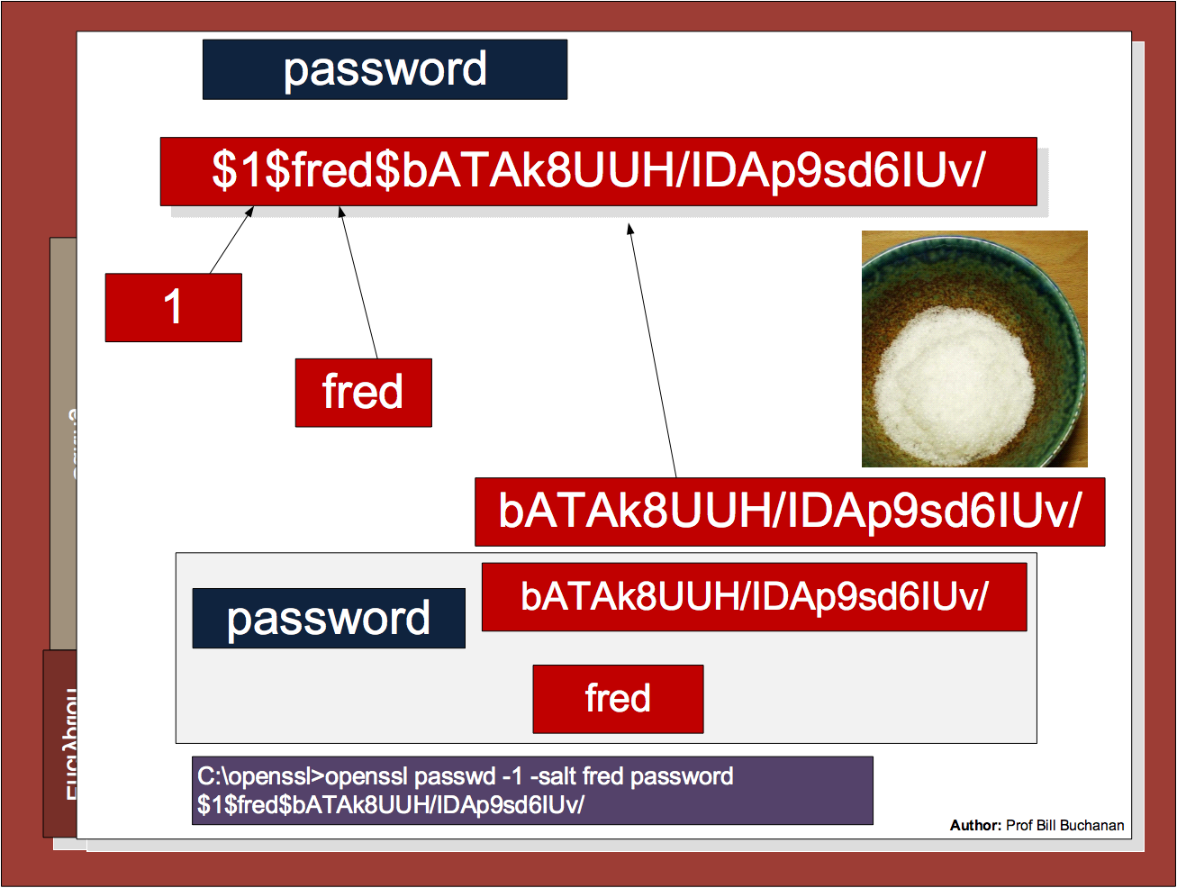

Slide 22
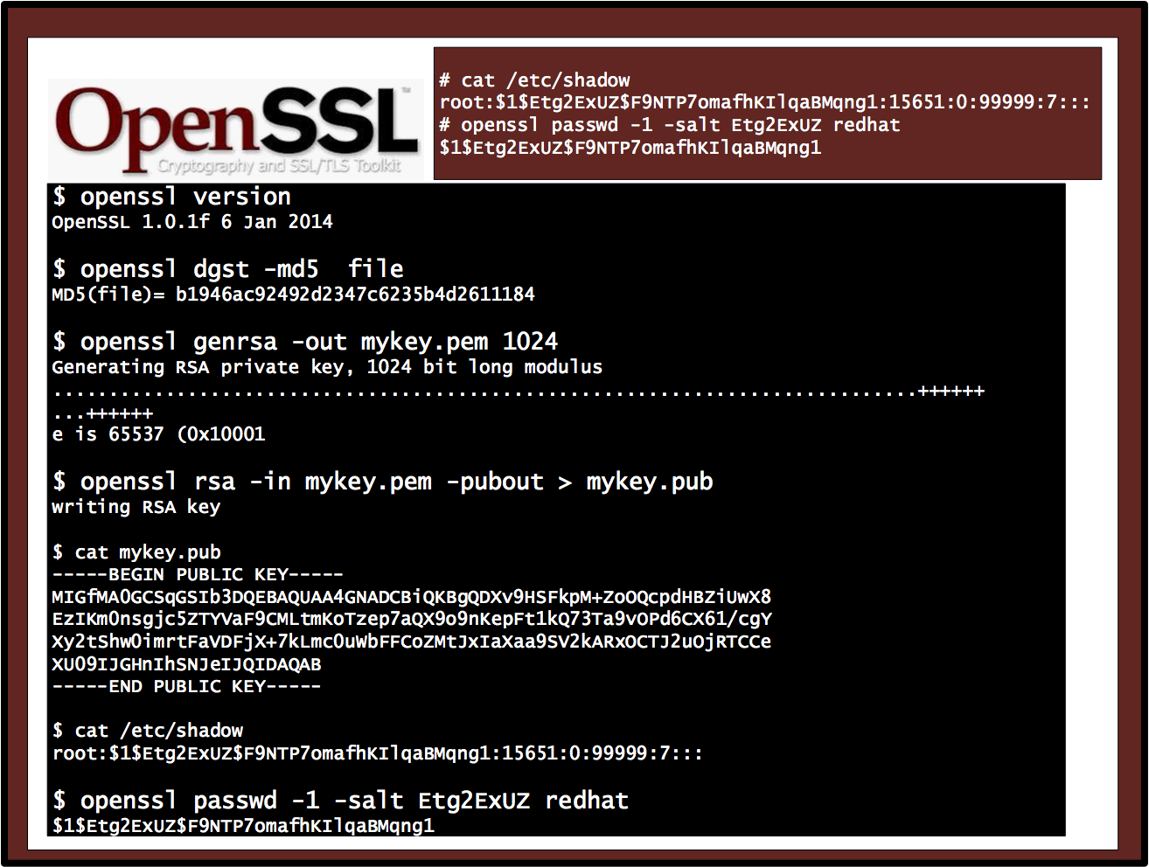

Slide 23
Unit 3: Hashing
Hashing Types.
Hashing Methods.
Salting.
Collisions.
LM and NTLM Hashes (Windows).
Hash Benchmarks.
Message Authentication Codes (MACs).
Key Derivation Function (KDF)
OTP/HOTP.
Hashcat.
Prof Bill Buchanan OBE https://asecuritysite.com/hash

Slide 24
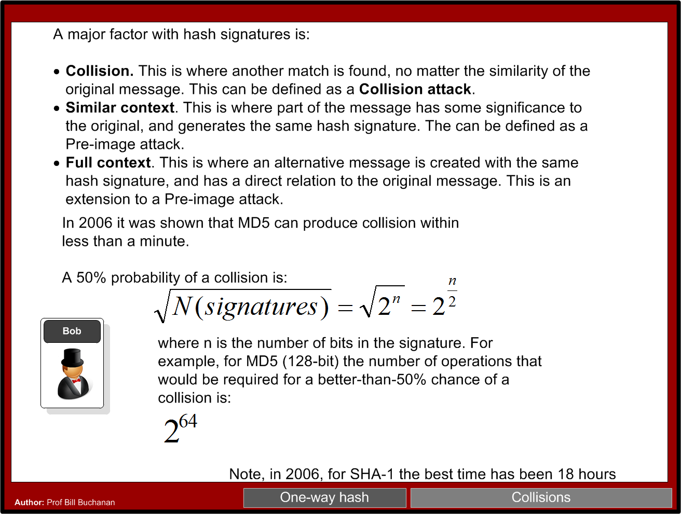

Slide 25
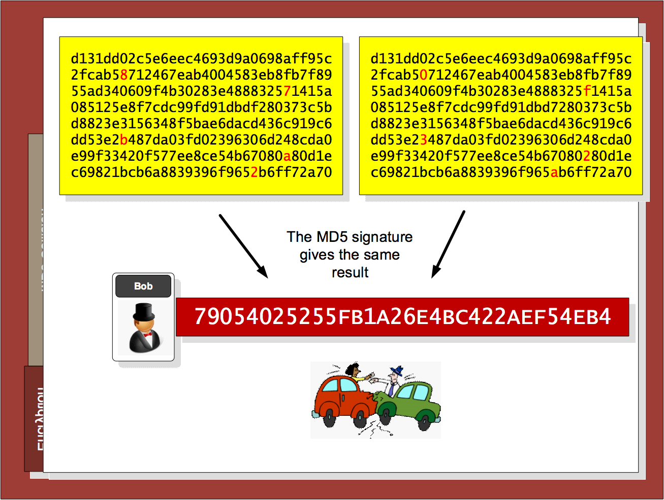

Slide 26
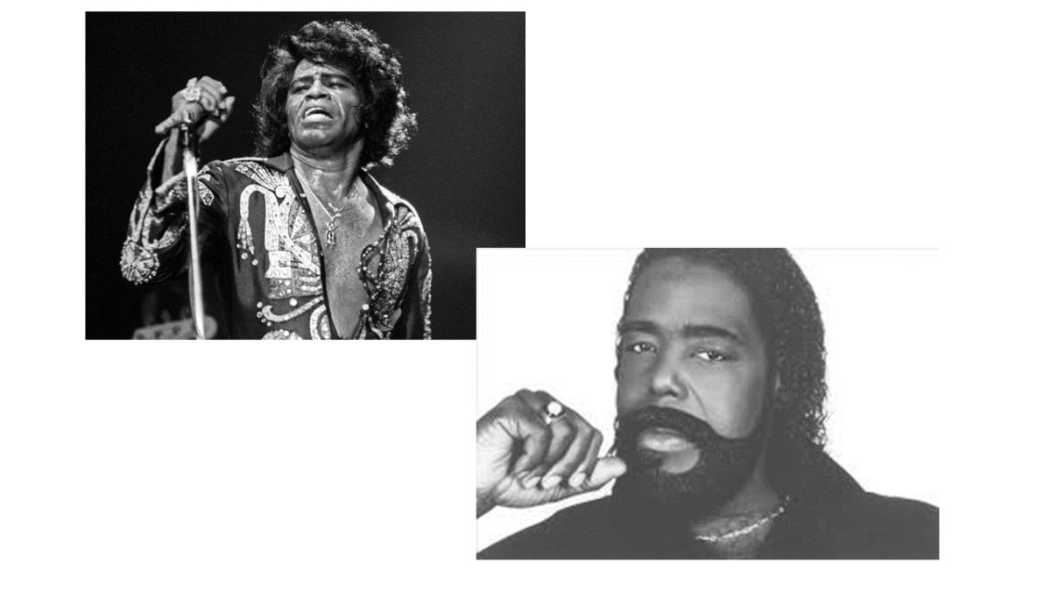
Nat McHugh
10 hours of computing on the Amazon GPU Cloud.
Cost: 60 cents
Used: Hashcat (on CUDA)
Birthday attack: A group size of only 70 people results in a 99.9% chance of two people sharing the same birthday.
M-bit output there are 2^m messages, and the same hash value would only require 2^(m/2) random messages. 18,446,744,073,709,551,616.
C:\openssl>openssl md5 hash01.jpg
MD5(hash01.jpg)= e06723d4961a0a3f950e7786f3766338
C:\openssl>openssl md5 hash02.jpg
MD5(hash02.jpg)= e06723d4961a0a3f950e7786f3766338

Slide 27
Chapter 3: Hashing
Hashing Types.
Hashing Methods.
Salting.
Collisions.
LM and NTLM Hashes (Windows).
Hash Benchmarks.
Message Authentication Codes (MACs).
Key Derivation Function (KDF)
OTP/HOTP.
Hashcat.
Prof Bill Buchanan OBE https://asecuritysite.com/hash

Slide 28
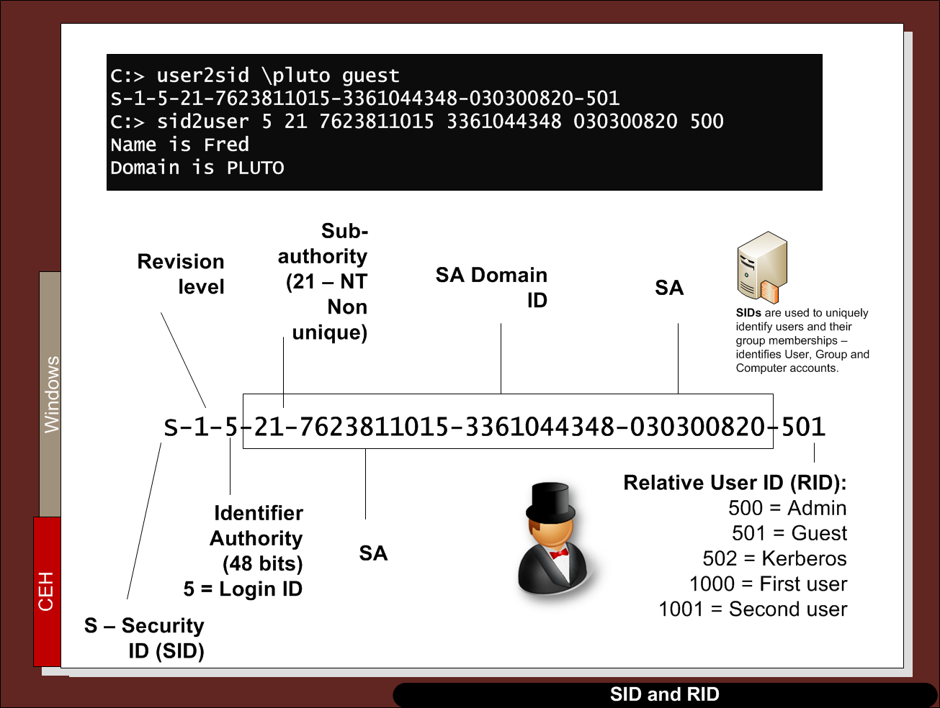

Slide 29
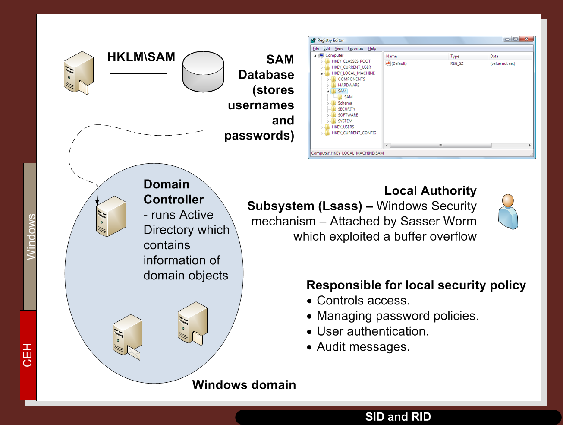

Slide 30
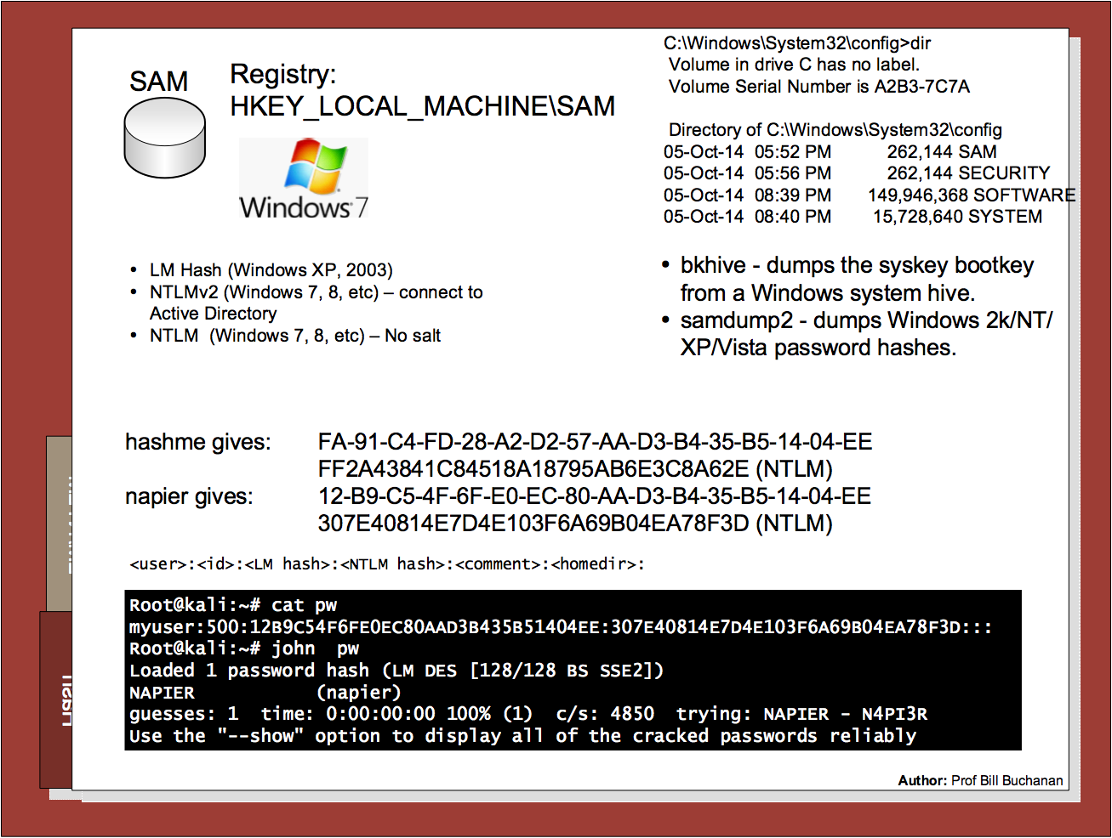

Slide 31
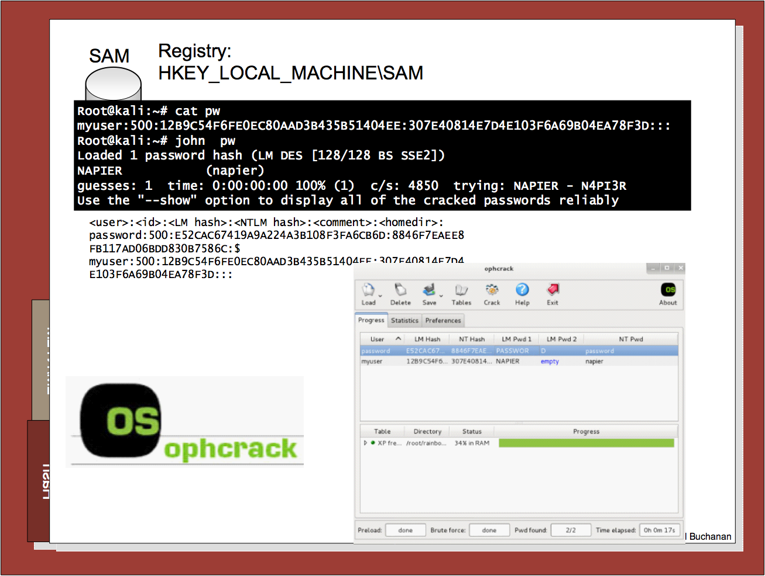

Slide 32
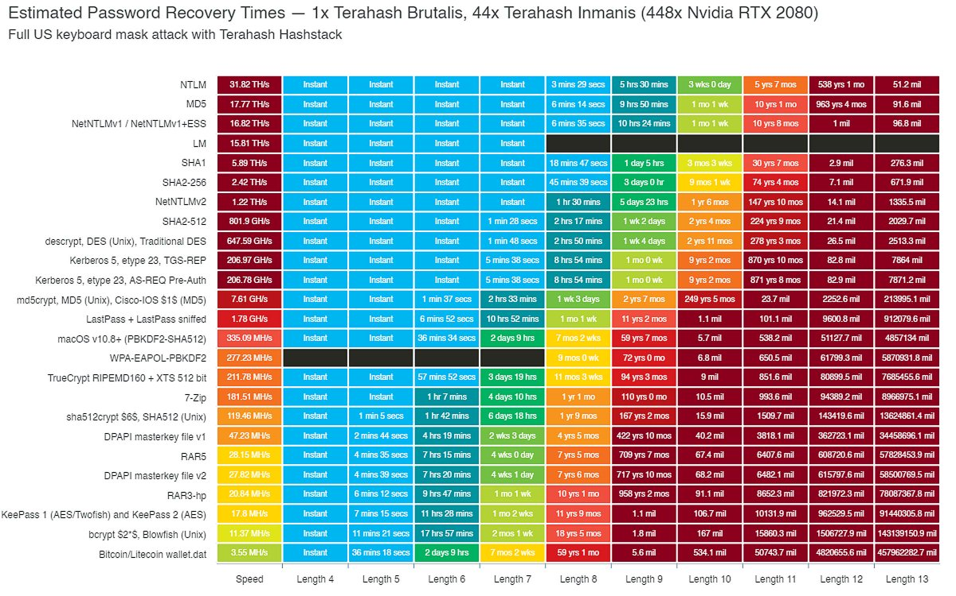
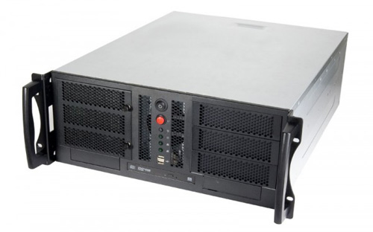
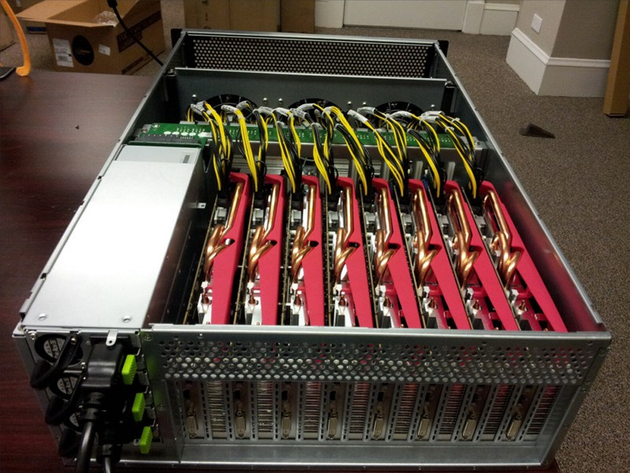
Hash Crackers/Bit Coin Miners
Fast Hash One
1.536TH/s – Cost 3-5,000 dollars.
25 GPU Hash Cracker
An eight character NTLM password cracked in 5.5 hours. 14 character LM hash cracked in six minutes. 350 billion hashes per second.

Slide 33
Unit 3: Hashing
Hashing Types.
Hashing Methods.
Salting.
Collisions.
LM and NTLM Hashes (Windows).
Hash Benchmarks.
Message Authentication Codes (MACs).
Key Derivation Function (KDF)
OTP/HOTP.
Hashcat.
Prof Bill Buchanan OBE https://asecuritysite.com/hash

Slide 34
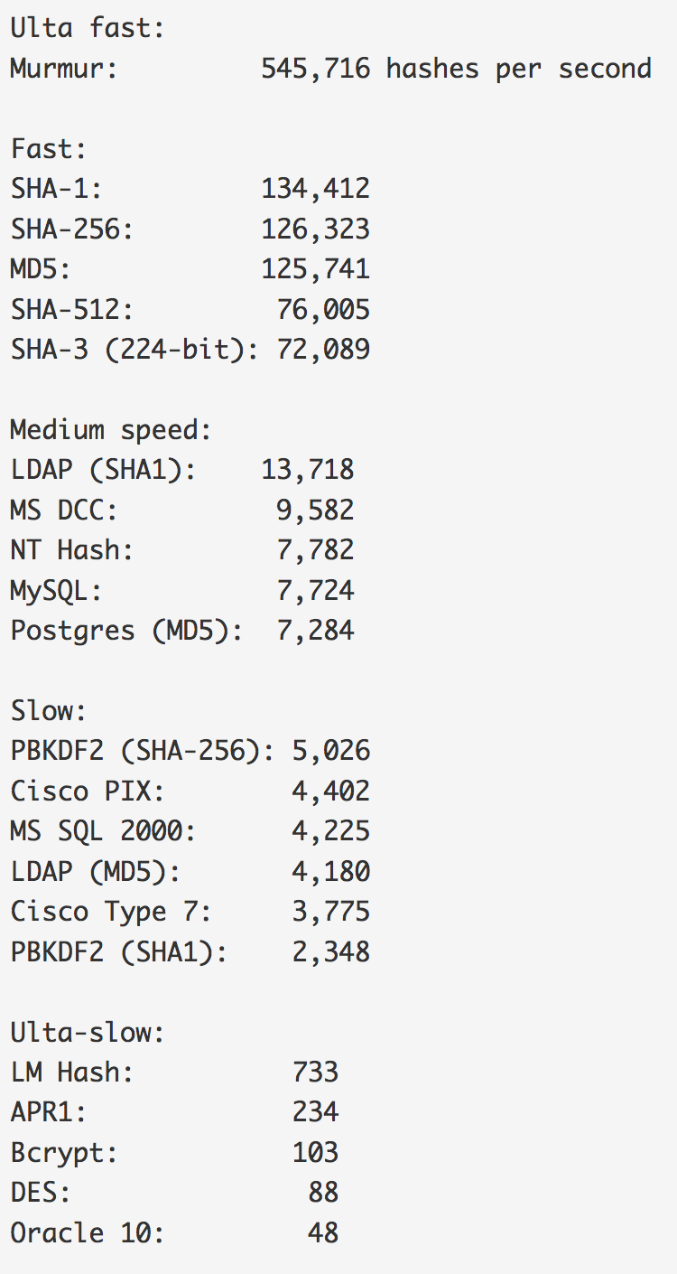
Benchmark
Hashes “The quick brown fox jumps over the lazy dog:
SHA-1: 2fd4e1c67a2d28fced849ee1bb76e7391b93eb12
SHA-256: d7a8fbb307d7809469ca9abcb0082e4f8d5651e46d3cdb762d02d0bf37c9e592
SHA-512: 07e547d9586f6a73f73fbac0435ed76951218fb7d0c8d788a309d7
85436bbb642e93a252a954f23912547d1e8a3b5ed6e1bfd7097821233fa0538f3db854fee6
MD-5: 9e107d9d372bb6826bd81d3542a419d6
DES: ZDeS94Lcq/6zg
Bcrypt: $2a$05$2czCv5GYgkx3aobmEyewB.ejV2hePMdbvTdCyNaSzWtlGPPjB2xx6
APR1: $apr1$ZDzPE45C$3PvRanPycmNc6c2G9wT9b/
PBKDF2 (SHA1): $pbkdf2$5$WkR6UEU0NUM$0RB2bimWrMY.EPYibpaBT2q3HFg
PBKDF2 (SHA-256): $pbkdf2-sha256$5$WkR6UEU0NUM$yrJz2oJix7uBJZwZ/50vWUgdE
I/i0ffqeU4obqC0pk4
LM Hash: a7b07f9948d8cc7f97c4b0b30cae500f
NT Hash: 4e6a076ae1b04a815fa6332f69e2e231
MS DCC: efa9778bbc94a7360f664eb7d7144725
LDAP (MD5): {MD5}9e107d9d372bb6826bd81d3542a419d6
LDAP (SHA1): {SHA}2fd4e1c67a2d28fced849ee1bb76e7391b93eb12
MS SQL 2000: 0x0100BF77CE595DCD1FC87A37B3DEBC27A8C97355CB96B8BAB
63E602662BA5D5D33B913E422499BE72FF3D9BB65DE
MySQL: *A4E4D26FD0C6455E23E2187C3AABE844332AA1B3
Oracle 10: 4CDA2299FCAD0499
Postgres (MD5): md5d44c15daa11770f25c5350f7e5408dd1
Cisco PIX: kGyKN5CqdFQ1qJUs
Cisco Type 7: 15260309443B3E2D2B3875200108010D41505640135E1B0E080
519574156401540035E460B594D1D53020B5C
Benchmark

Slide 35
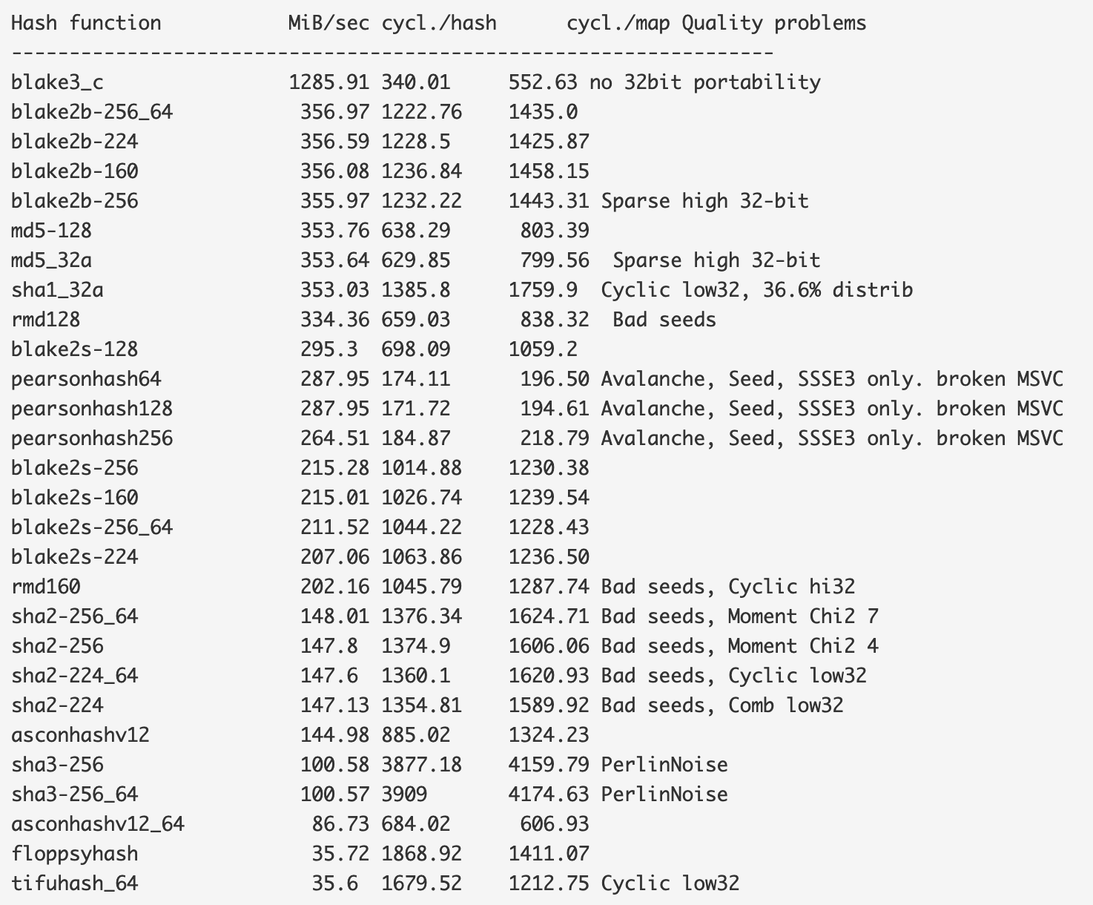
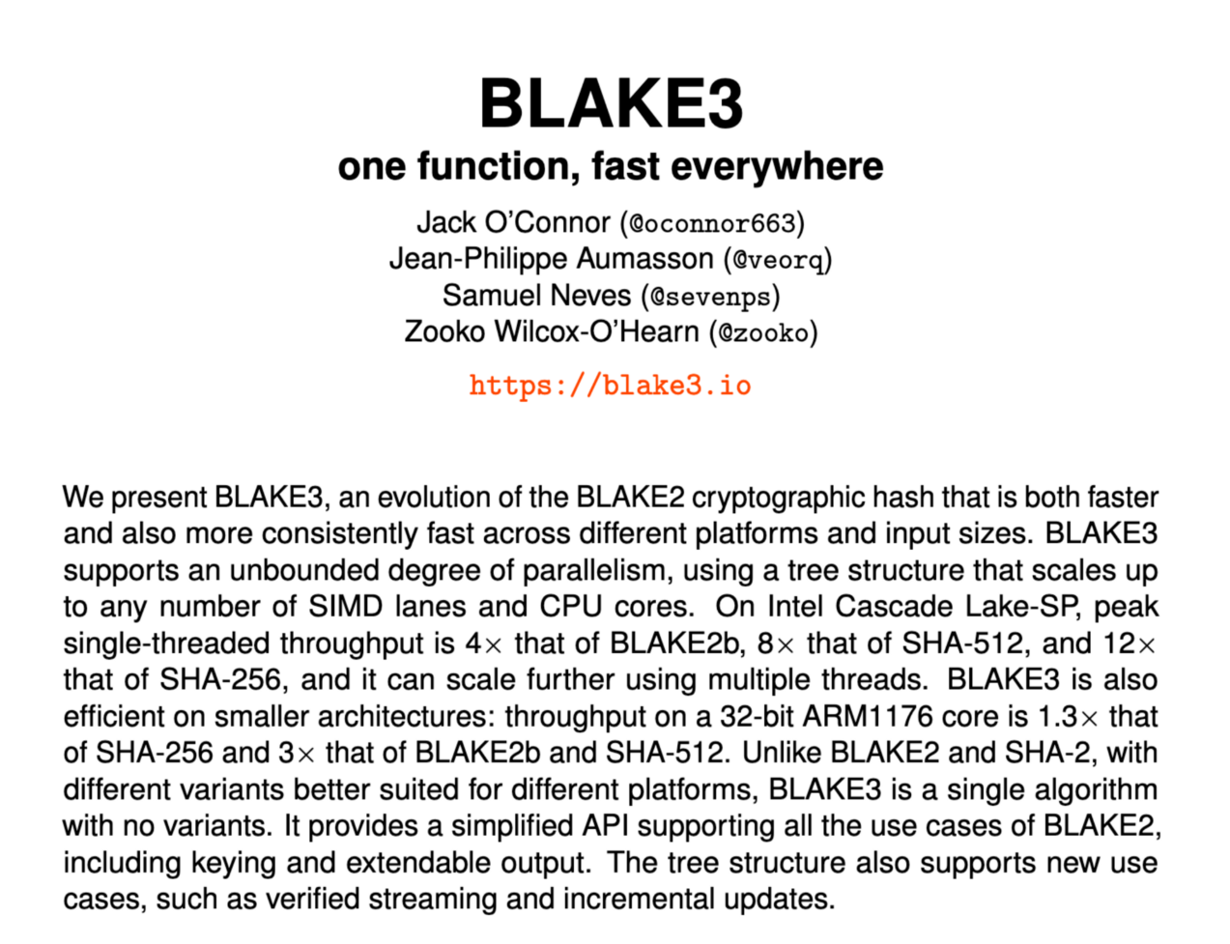
BLAKE 3
View

Slide 36
Slowing a hash
To slow the hash, we can use rounds, where we continually hash for a number of rounds. In the following we use 5,000 rounds:
===Splunk hashed password===
User: Fred
Password: qwerty123
Salt: Uk8SVGLsBuSmD75R
===Hashed password Fred:$6$Uk8SVGLsBuSmD75R$Lhp5yjwRUAM.LbH5IIthZ1u0bAUdJwBvvccBshAvpFPiRn62EYeiKOaP8xh97aV4UaNfVykRZhUy/3ZOZd1oc.
root@kali:~# hashcat -b -m 1800
Initializing hashcat v0.49 with 1 threads and 32mb segment-size…
Device………..: Intel(R) Core(TM) i7–8850H CPU 2.60GHz
Instruction set..: x86_64
Number of threads: 1
Hash type: sha512crypt, SHA512(Unix)
Speed/sec: 454 words
root@kali:~# hashcat -b -m 0
Initializing hashcat v0.49 with 1 threads and 32mb segment-size…
Device: Intel(R) Core(TM) i7–8850H CPU 2.60GHz
Instruction set..: x86_64
Number of threads: 1
Hash type: MD5
Speed/sec: 17.33M words
SHA512-crypt

Slide 37
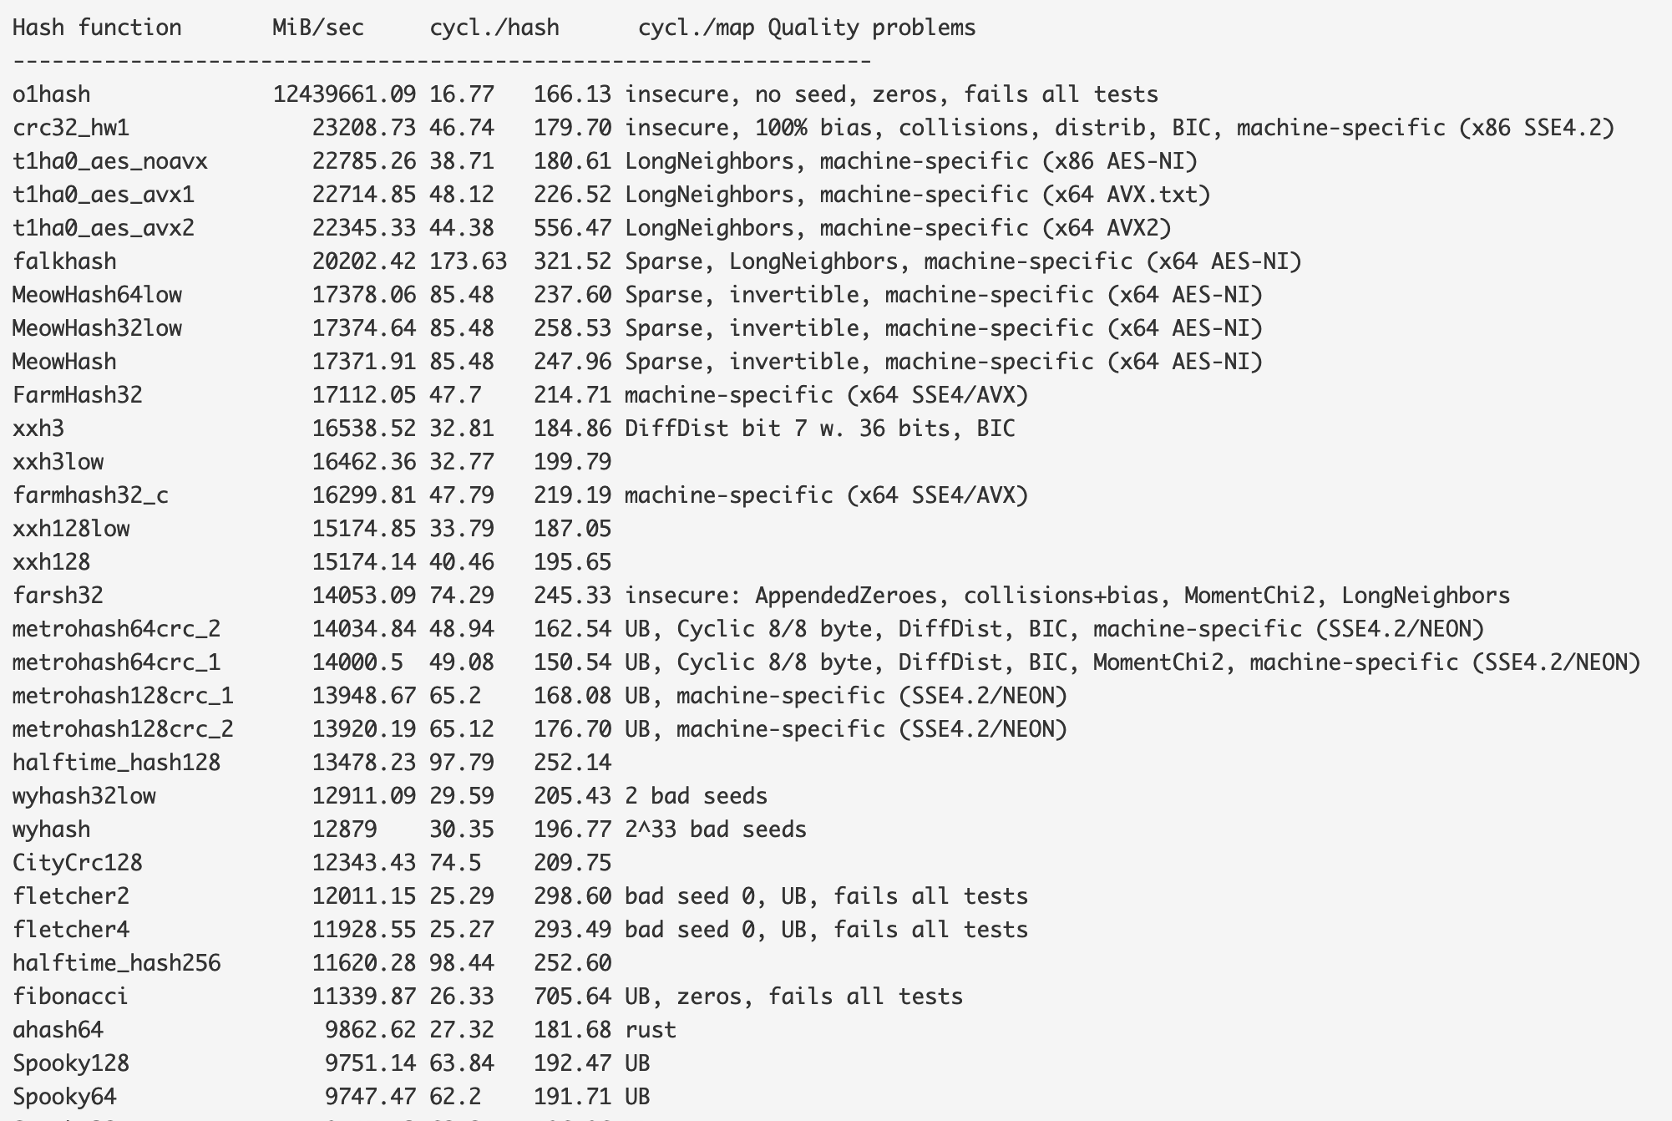
Non-cryptographic hashing
Used for hash tables. Google recommend the following for 64-bit hashes without quality problems:
xxh3low
wyhash
ahash64
t1ha2_atonce
FarmHash
halftime_hash128
Spooky32
pengyhash
nmhash32
mx3
MUM/mir
fasthash32
Non-crypto

Slide 38
Unit 3: Hashing
Hashing Types.
Hashing Methods.
Salting.
Collisions.
LM and NTLM Hashes (Windows).
Hash Benchmarks.
Message Authentication Codes (MACs).
Key Derivation Function (KDF)
OTP/HOTP.
Hashcat.
Prof Bill Buchanan OBE https://asecuritysite.com/hash

Slide 39

Hashing

Slide 40
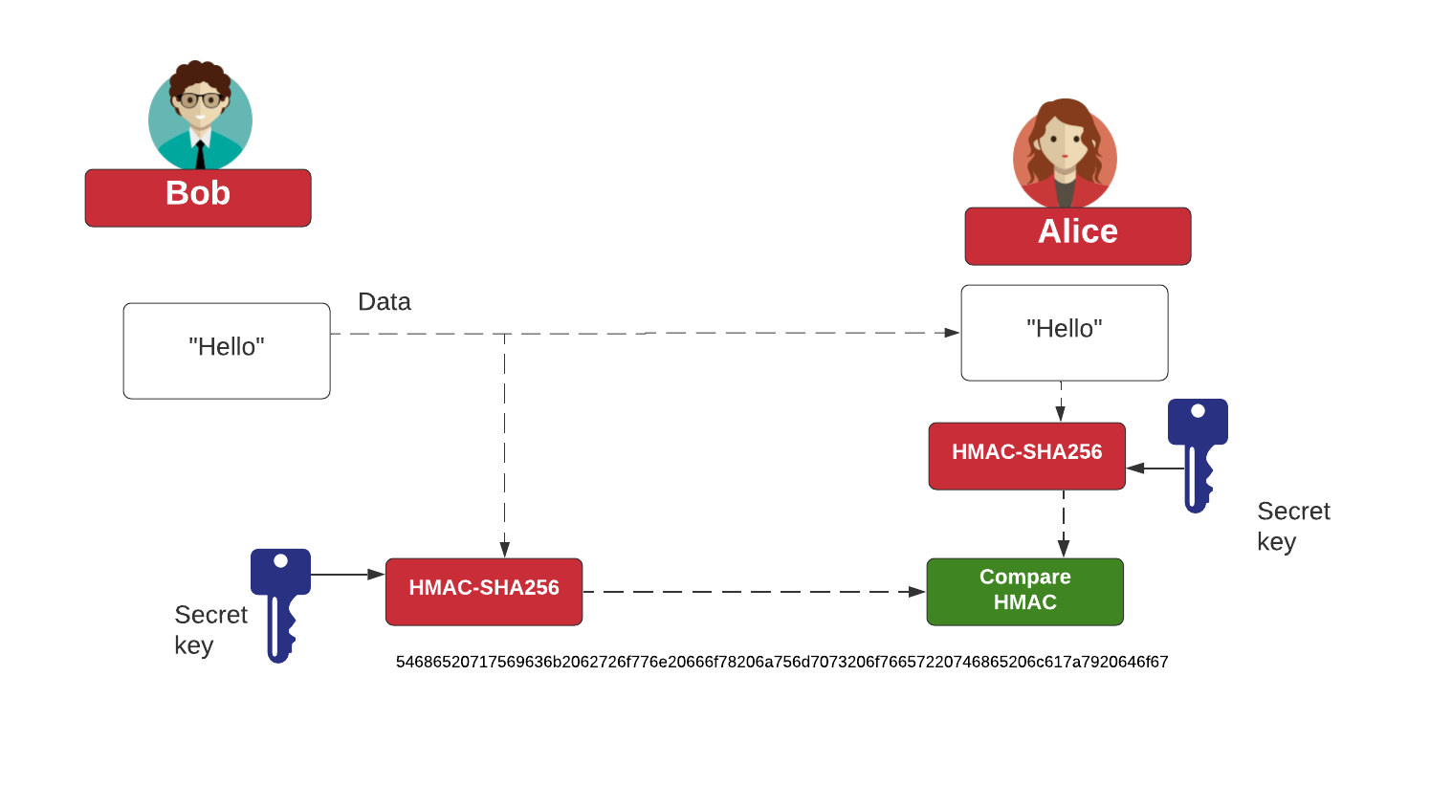
HMAC

Slide 41
Unit 3: Hashing
Hashing Types.
Hashing Methods.
Salting.
Collisions.
LM and NTLM Hashes (Windows).
Hash Benchmarks.
Message Authentication Codes (MACs).
Key Derivation Functions (KDF)
OTP/HOTP.
Hashcat.
Prof Bill Buchanan OBE https://asecuritysite.com/hash

Slide 42
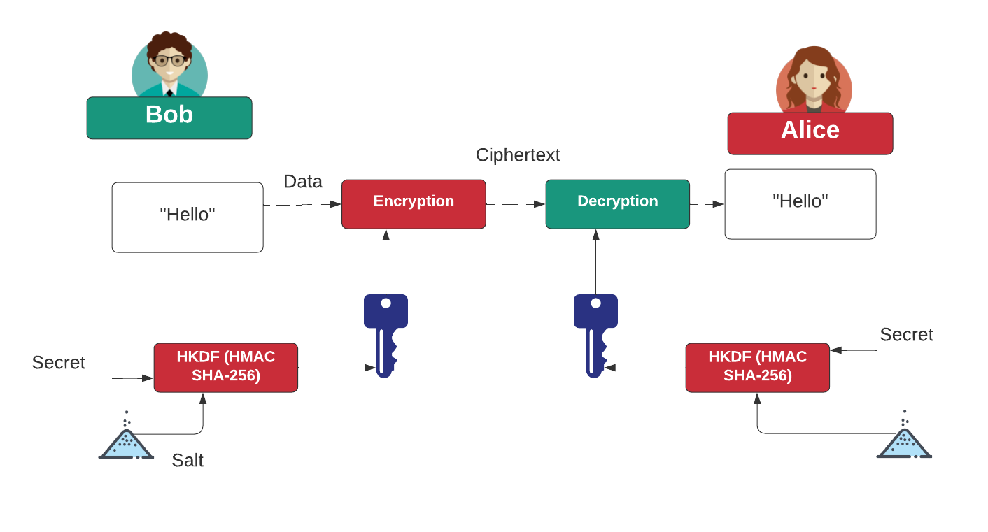
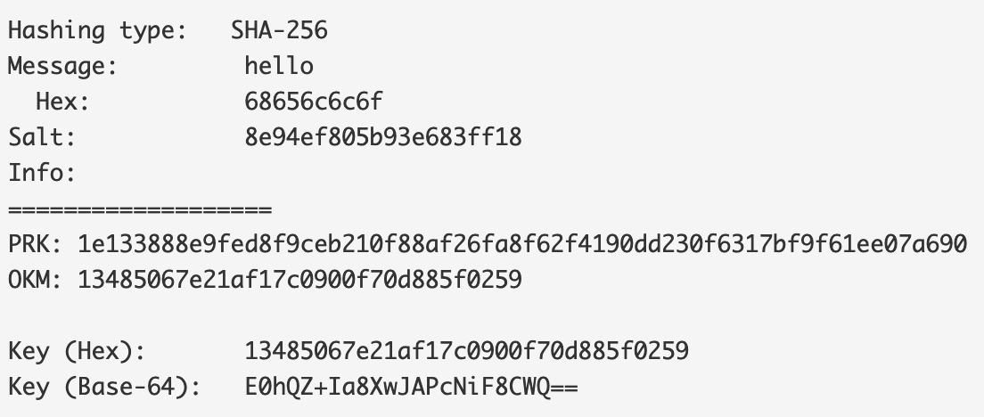
HKDF
HKDF

Slide 43
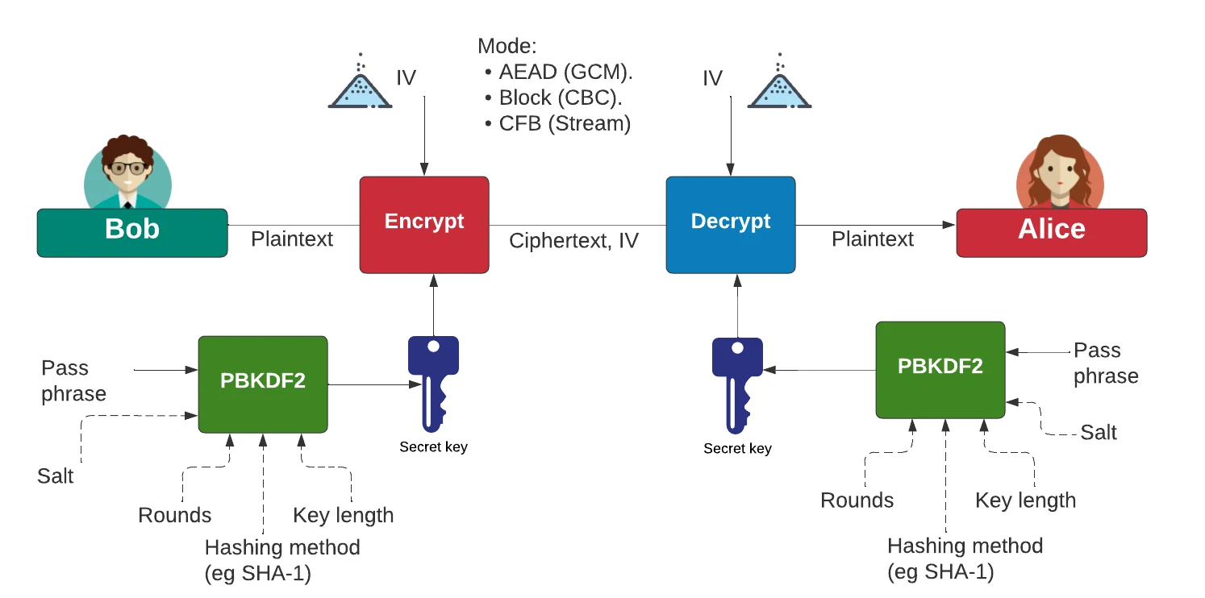
PBKDF2, bcrypt and scrypt
scrypt
Bcrypt
PBKDF2

Slide 44
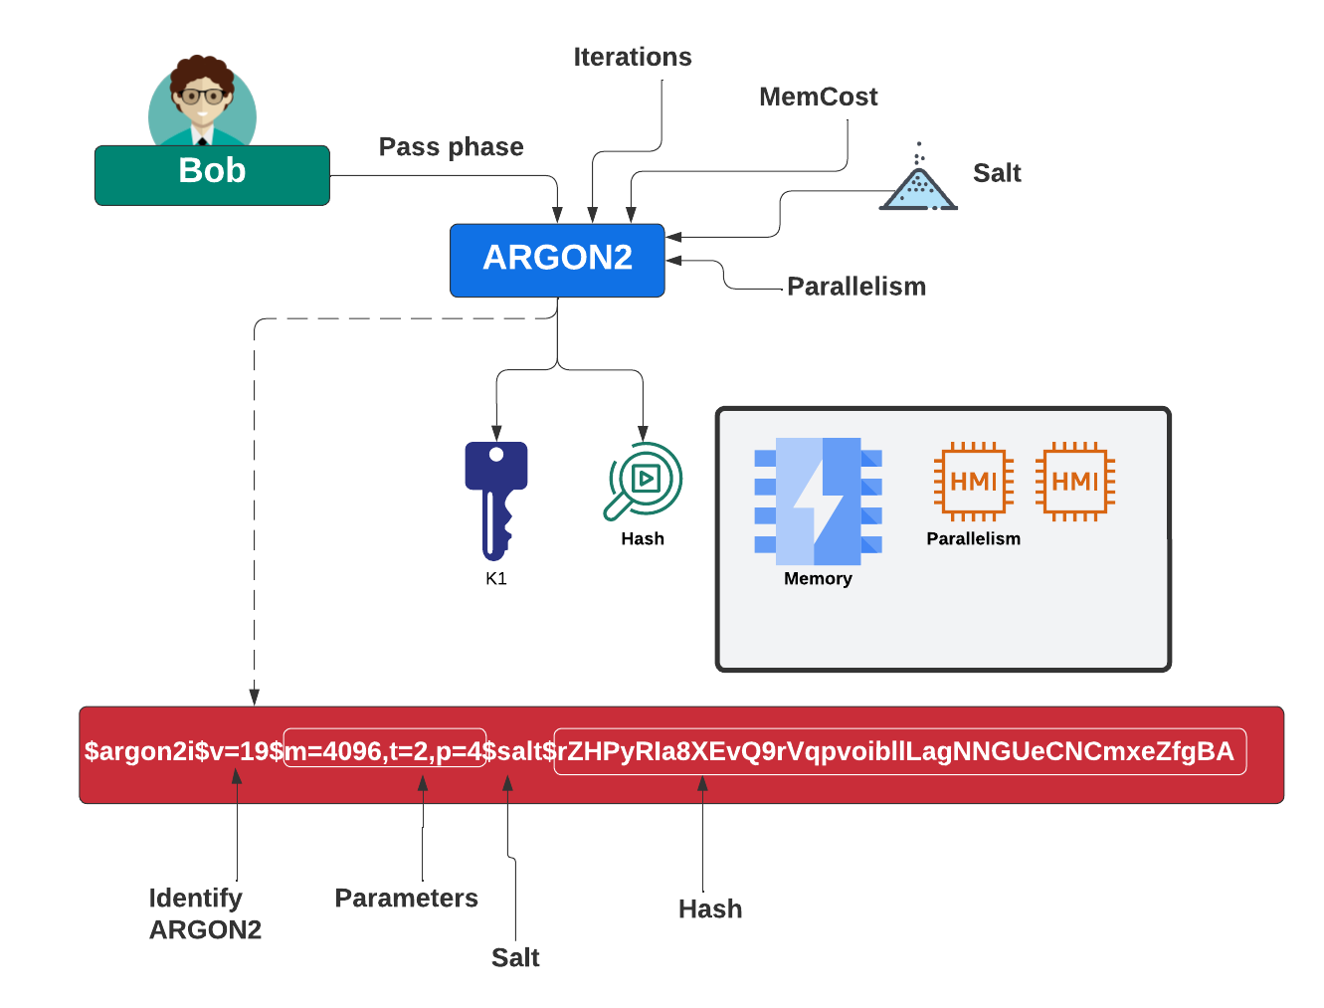
PBKDF2, bcrypt and Argon 2
Argon 2

Slide 45
Unit 3: Hashing
Hashing Types.
Hashing Methods.
Salting.
Collisions.
LM and NTLM Hashes (Windows).
Hash Benchmarks.
Message Authentication Codes (MACs).
OTP/HOTP.
Hashcat.
Prof Bill Buchanan OBE https://asecuritysite.com/hash

Slide 46
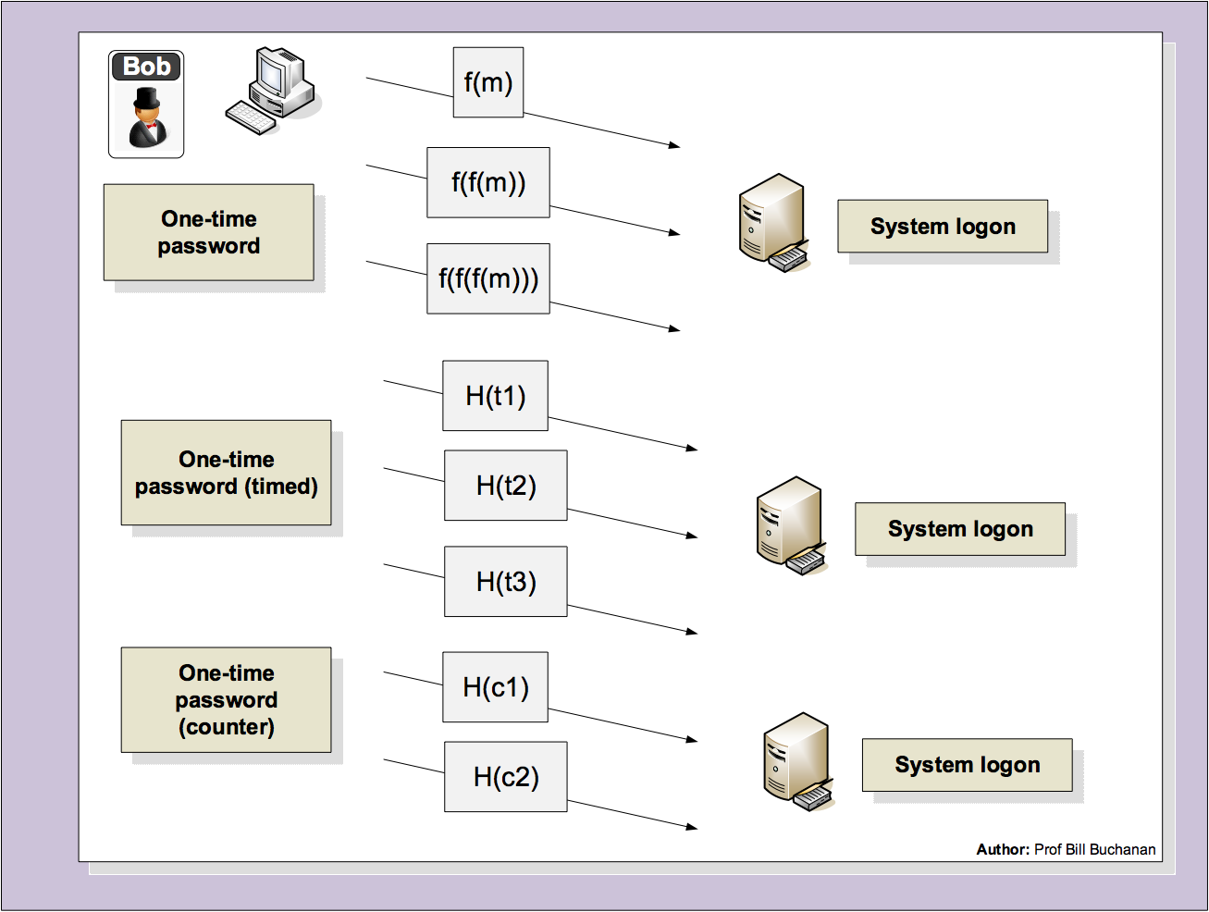

Slide 47
Unit 3: Hashing
Hashing Types.
Hashing Methods.
Salting.
Collisions.
LM and NTLM Hashes (Windows).
Hash Benchmarks.
Message Authentication Codes (MACs).
Key Derivation Function (KDF)
OTP/HOTP.
Hashcat
Prof Bill Buchanan OBE https://asecuritysite.com/hash

Slide 48
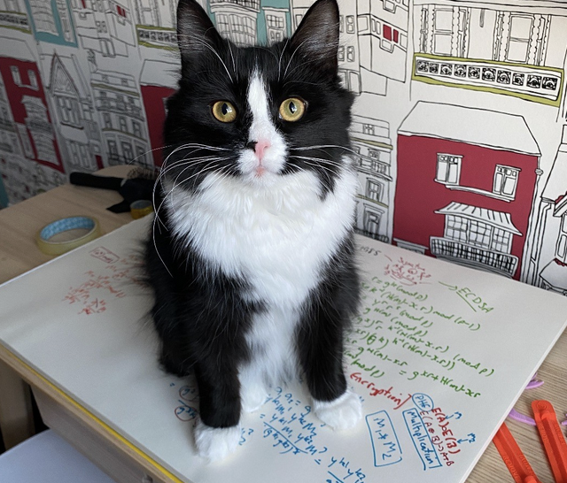
Hashing
Hashcat
Prof Bill Buchanan OBE https://asecuritysite.com/hash

Slide 49
Hashcat
Rule-based Attacks. Define a rule of the password.
Dictionary Attacks. Search through a dictionary of common passwords.
Brute-Force Attacks. Search through
Attack modes: Brute-force, Combinator, Dictionary, Mask, Rule-based, Toggle-case and Hybrid.

Slide 50
Hashcat
* General:
-m, --hash-type=NUM Hash-type, see references below
-a, --attack-mode=NUM Attack-mode, see references below
* Benchmark:
-b, --benchmark Run benchmark
* Files:
-o, --outfile=FILE Define outfile for recovered hash
--outfile-format=NUM Define outfile-format for recovered hash, see references below
--show Show cracked passwords only (see --username)
* Resources:
-c, --segment-size=NUM Size in MB to cache from the wordfile
-n, --threads=NUM Number of threads
* Rules:
-r, --rules-file=FILE Rules-file use: -r 1.rule
-g, --generate-rules=NUM Generate NUM random rules
--generate-rules-func-min=NUM Force NUM functions per random rule min
--generate-rules-func-max=NUM Force NUM functions per random rule max
* Toggle-Case attack-mode specific:
--toggle-min=NUM Number of alphas in dictionary minimum
--toggle-max=NUM Number of alphas in dictionary maximum
* Mask-attack attack-mode specific:
--pw-min=NUM Password-length minimum
--pw-max=NUM Password-length maximum
* Permutation attack-mode specific:
--perm-min=NUM Filter words shorter than NUM
--perm-max=NUM Filter words larger than NUM
* Table-Lookup attack-mode specific:
-t, --table-file=FILE Table file
--table-min=NUM Number of chars in dictionary minimum
--table-max=NUM Number of chars in dictionary maximum
hashcat [options] hashfile [mask|wordfiles|directories]
hashcat -m 0 myhash myfile.txt -o output.txt

Slide 51
Hashcat
-a, --attack-mode=NUM
Attack Modes:
0 = Straight
1 = Combination
2 = Toggle-Case
3 = Brute-force
4 = Permutation
5 = Table-Lookup
6 = Prince
hashcat [options] hashfile [mask|wordfiles|directories]
hashcat -m 0 myhash myfile.txt -o output.txt

Slide 52
Hashcat
-a, --attack-mode=NUM
-m hash-type
* Hash types:
0 = MD5
10 = md5($pass.$salt)
20 = md5($salt.$pass)
30 = md5(unicode($pass).$salt)
40 = md5($salt.unicode($pass))
50 = HMAC-MD5 (key = $pass)
60 = HMAC-MD5 (key = $salt)
100 = SHA1
110 = sha1($pass.$salt)
120 = sha1($salt.$pass)
130 = sha1(unicode($pass).$salt)
140 = sha1($salt.unicode($pass))
150 = HMAC-SHA1 (key = $pass)
160 = HMAC-SHA1 (key = $salt)
200 = MySQL323
300 = MySQL4.1/MySQL5
400 = phpass, MD5(Wordpress), MD5(phpBB3), MD5(Joomla)
500 = md5crypt, MD5(Unix), FreeBSD MD5, Cisco-IOS MD5
900 = MD4
1000 = NTLM
1400 = SHA256
1410 = sha256($pass.$salt)
5500 = NetNTLMv1-VANILLA / NetNTLMv1-ESS
5600 = NetNTLMv2
5700 = Cisco-IOS SHA256
8900 = scrypt
9200 = Cisco $8$
10000 = Django (PBKDF2-SHA256)
hashcat [options] hashfile [mask|wordfiles|directories]
hashcat -m 0 myhash myfile.txt -o output.txt

Slide 53
Hashcat - Outputs
Output format
1 = hash[:salt]
2 = plain
3 = hash[:salt]:plain
4 = hex_plain
5 = hash[:salt]:hex_plain
6 = plain:hex_plain
7 = hash[:salt]:plain:hex_plain
8 = crackpos
9 = hash[:salt]:crackpos
10 = plain:crackpos
11 = hash[:salt]:plain:crackpos
12 = hex_plain:crackpos
13 = hash[:salt]:hex_plain:crackpos
14 = plain:hex_plain:crackpos
15 = hash[:salt]:plain:hex_plain:crackpos
hashcat [options] hashfile [mask|wordfiles|directories]
hashcat -m 0 myhash myfile.txt -o output.txt

Slide 54
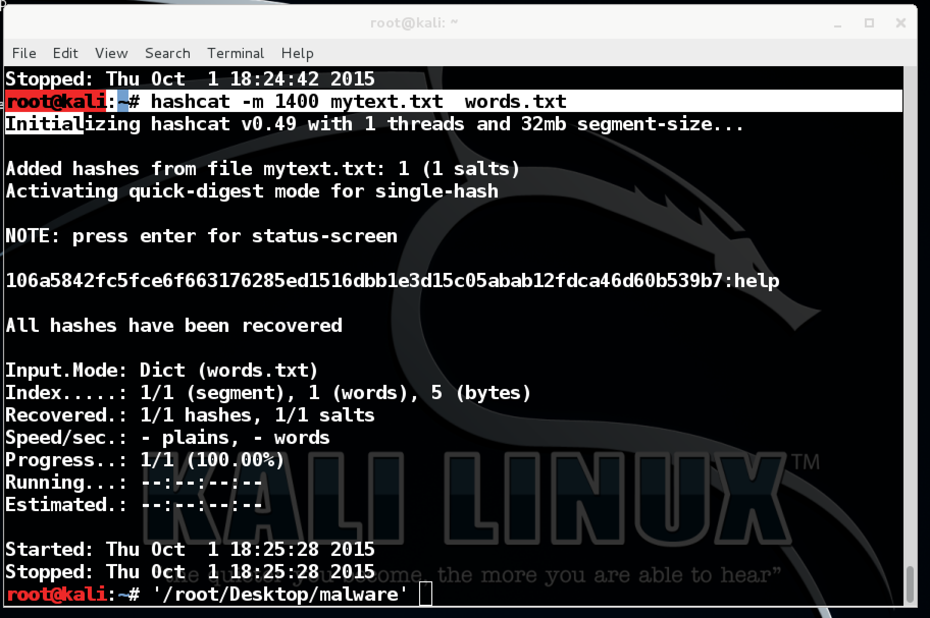
Hashcat
hashcat -m 1400 mytext.txt words.txt

Slide 55
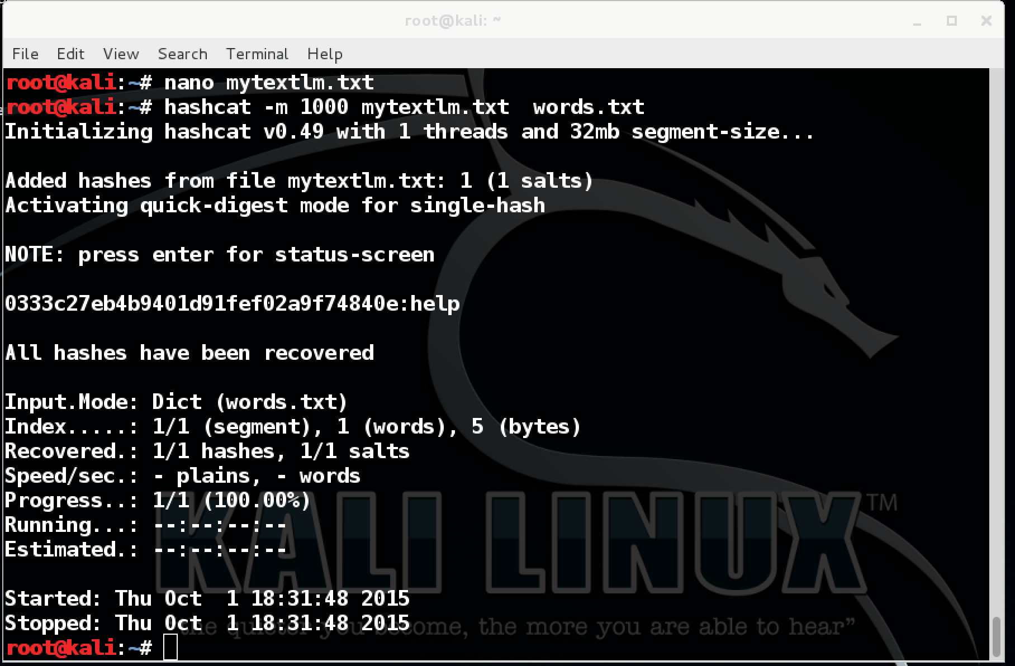
Hashcat
hashcat -m 1000 mytextnt.txt words.txt

Slide 56
Combinational Attack (-a 1)
Hashcat -m 0 -a 1 hash.txt dict1.txt dict2.txt
dict1.txt
jam
jar
jimmy
jamie
jamcar
jarcar
Jimmycar
Jamiecar
jamcat
jarcat
jimmycat
jamiecat
dict2.txt
car
cat
call

Slide 57
Hashing
Brute Force (-a 3)
Prof Bill Buchanan OBE https://asecuritysite.com/hash

Slide 58
Hashcat – Brute Force
hashcat [options] hashfile [mask|wordfiles|directories]
hashcat -m 0 myhash myfile.txt -o output.txt
Custom charsets:
-1, --custom-charset1=CS User-defined charsets
-2, --custom-charset2=CS Example:
-3, --custom-charset3=CS --custom-charset1=?dabcdef : sets charset ?1 to 0123456789abcdef
-4, --custom-charset4=CS -2 mycharset.hcchr : sets charset ?2 to chars contained in file
Character sets
?l = abcdefghijklmnopqrstuvwxyz
?u = ABCDEFGHIJKLMNOPQRSTUVWXYZ
?d = 0123456789
?s = !"#$%&'()*+,-./:;<=>?@[\]^_`{|}~
?a = ?l?u?d?s
?b = 0x00 - 0xff

Slide 59
Hashcat – Brute Force
?l = abcdefghijklmnopqrstuvwxyz
?u = ABCDEFGHIJKLMNOPQRSTUVWXYZ
?d = 0123456789
?s = !"#$%&'()*+,-./:;<=>?@[\]^_`{|}~
?a = ?l?u?d?s
?b = 0x00 - 0xff
aaaaaaaa
aaaaaaab
…
zzzzzzzz
-1 abcdefghijklmnopqrstuvwxyz0123456789
-1 abcdefghijklmnopqrstuvwxyz?d
-1 ?l0123456789-1 ?l?d

Slide 60
Hashcat –
Brute Force
Input.Mode: Mask (?l) [1]
Index.....: 0/1 (segment), 26 (words), 0 (bytes)
Recovered.: 0/1 hashes, 0/1 salts
Speed/sec.: - plains, - words
Progress..: 26/26 (100.00%)
Running...: --:--:--:--
Estimated.: --:--:--:--
Input.Mode: Mask (?l?l) [2]
Index.....: 0/1 (segment), 676 (words), 0 (bytes)
Recovered.: 0/1 hashes, 0/1 salts
Speed/sec.: - plains, - words
Progress..: 676/676 (100.00%)
Running...: --:--:--:--
Estimated.: --:--:--:--
Input.Mode: Mask (?l?l?l) [3]
Index.....: 0/1 (segment), 17576 (words), 0 (bytes)
Recovered.: 0/1 hashes, 0/1 salts
Speed/sec.: - plains, - words
Progress..: 17576/17576 (100.00%)
Running...: --:--:--:--
Estimated.: --:--:--:--
0333c27eb4b9401d91fef02a9f74840e:help
All hashes have been recovered
Input.Mode: Mask (?l?l?l?l) [4]
Index.....: 0/1 (segment), 456976 (words), 0 (bytes)
Recovered.: 1/1 hashes, 1/1 salts
Speed/sec.: - plains, - words
Progress..: 271188/456976 (59.34%)
Running...: --:--:--:--
Estimated.: --:--:--:--
hashcat -a 3 -m 1000 mytextlm.txt ?l?l?l?l?l?l?l?l
[keyspace: aaaaaaaa – zzzzzzzz]

Slide 61
Hashcat –
Brute Force
Input.Mode: Mask (h) [1]
Index.....: 0/1 (segment), 1 (words), 0 (bytes)
Recovered.: 0/1 hashes, 0/1 salts
Speed/sec.: - plains, - words
Progress..: 1/1 (100.00%)
Running...: --:--:--:--
Estimated.: --:--:--:--
Input.Mode: Mask (he) [2]
Index.....: 0/1 (segment), 1 (words), 0 (bytes)
Recovered.: 0/1 hashes, 0/1 salts
Speed/sec.: - plains, - words
Progress..: 1/1 (100.00%)
Running...: --:--:--:--
Estimated.: --:--:--:--
Input.Mode: Mask (hel) [3]
Index.....: 0/1 (segment), 1 (words), 0 (bytes)
Recovered.: 0/1 hashes, 0/1 salts
Speed/sec.: - plains, - words
Progress..: 1/1 (100.00%)
Running...: --:--:--:--
Estimated.: --:--:--:--
0333c27eb4b9401d91fef02a9f74840e:help
All hashes have been recovered
Input.Mode: Mask (hel?l) [4]
Index.....: 0/1 (segment), 26 (words), 0 (bytes)
Recovered.: 1/1 hashes, 1/1 salts
Speed/sec.: - plains, - words
Progress..: 16/26 (61.54%)
Running...: --:--:--:--
Estimated.: --:--:--:--
hashcat -a 3 -m 1000 mytextlm.txt hel?l
[keyspace: hela - help]

Slide 62
Hashcat –
Brute Force
…
b1b735762130797915df96acf5bf09b8:hel9
All hashes have been recovered
Input.Mode: Mask (hel?d) [4]
Index.....: 0/1 (segment), 10 (words), 0 (bytes)
Recovered.: 1/1 hashes, 1/1 salts
Speed/sec.: - plains, - words
Progress..: 10/10 (100.00%)
Running...: --:--:--:--
Estimated.: --:--:--:--
hashcat -a 3 -m 1000 mytextlm.txt hel?d
[keyspace: hela - help]

Slide 63
Unit 3: Hashing
Rules and Lists
Prof Bill Buchanan OBE http://asecuritysite.com/crypto02 http://asecuritysite.com/encryption

Slide 64
Hashcat – Password List
root@kali:~# wc -l /usr/share/wordlists/rockyou.txt
14344392 /usr/share/wordlists/rockyou.txt
Name | Function | Description | Example Rule | Input Word | Output Word
Nothing | : | Do nothing | : | p@ssW0rd | p@ssW0rd
Lowercase | l | Lowercase all letters | l | p@ssW0rd | p@ssw0rd
Uppercase | u | Uppercase all letters | u | p@ssW0rd | P@SSW0RD
Capitalize | c | Capitalize the first letter and lower the rest | c | p@ssW0rd | P@ssw0rd
Append Character | $X | Append character X to end | $1 | p@ssW0rd | p@ssW0rd1
Prepend Character | ^X | Prepend character X to front | ^1 | p@ssW0rd | 1p@ssW0rd
Replace | sXY | Replace all instances of X with Y | ss$ | p@ssW0rd | p@$$W0rd
root@kali:~# hashcat -m 0 mytextmd.txt /usr/share/wordlists/rockyou.txt
Initializing hashcat v0.49 with 1 threads and 32mb segment-size...
Added hashes from file mytextmd.txt: 1 (1 salts)
Activating quick-digest mode for single-hash
NOTE: press enter for status-screen
25f9e794323b453885f5181f1b624d0b:123456789
All hashes have been recovered
Input.Mode: Dict (/usr/share/wordlists/rockyou.txt)
Index.....: 1/5 (segment), 3627099 (words), 33550339 (bytes)
Recovered.: 1/1 hashes, 1/1 salts
Speed/sec.: - plains, - words
Progress..: 4/3627099 (0.00%)
123456
12345
123456789
password
iloveyou
princess
1234567
rockyou
12345678
abc123
nicole
daniel
babygirl
monkey
lovely
jessica
anthony
friends
butterfly

Slide 65
Hashcat – Rules
Name Function Description Example Rule Input Word Output Word
Nothing : Do nothing : p@ssW0rd p@ssW0rd
Lowercase l Lowercase l p@ssW0rd p@ssw0rd
Uppercase u Uppercase u p@ssW0rd P@SSW0RD
Capitalize c Capitalize 1st, lower rest c p@ssW0rd P@ssw0rd
Append $X Append character X to end $1 p@ssW0rd p@ssW0rd1
Prepend ^X Prepend character X to front ^1 p@ssW0rd 1p@ssW0rd
Replace sXY Replace all instances of X with Y ss$ p@ssW0rd p@$$W0rd
Name | Function | Description | Example Rule | Input Word | Output Word
Nothing | : | Do nothing | : | p@ssW0rd | p@ssW0rd
Lowercase | l | Lowercase all letters | l | p@ssW0rd | p@ssw0rd
Uppercase | u | Uppercase all letters | u | p@ssW0rd | P@SSW0RD
Capitalize | c | Capitalize the first letter and lower the rest | c | p@ssW0rd | P@ssw0rd
Append Character | $X | Append character X to end | $1 | p@ssW0rd | p@ssW0rd1
Prepend Character | ^X | Prepend character X to front | ^1 | p@ssW0rd | 1p@ssW0rd
Replace | sXY | Replace all instances of X with Y | ss$ | p@ssW0rd | p@$$W0rd
root@kali:~# ls /usr/share/hashcat/rules
best64.rule specific.rule
combinator.rule T0XlC-insert_00-99_1950-2050_toprules_0_F.rule
d3ad0ne.rule T0XlC-insert_space_and_special_0_F.rule
dive.rule T0XlC-insert_top_100_passwords_1_G.rule
generated.rule T0XlC.rule
Incisive-leetspeak.rule T0XlCv1.rule
InsidePro-HashManager.rule toggles1.rule
InsidePro-PasswordsPro.rule toggles2.rule
leetspeak.rule toggles3.rule
Ninja-leetspeak.rule toggles4.rule
oscommerce.rule toggles5.rule
rockyou-30000.rule

Slide 66
Name Function Description Example Rule Input Word Output Word
Nothing : Do nothing : p@ssW0rd p@ssW0rd
Lowercase l Lowercase l p@ssW0rd p@ssw0rd
Uppercase u Uppercase u p@ssW0rd P@SSW0RD
Capitalize c Capitalize 1st, lower rest c p@ssW0rd P@ssw0rd
Append $X Append character X to end $1 p@ssW0rd p@ssW0rd1
Prepend ^X Prepend character X to front ^1 p@ssW0rd 1p@ssW0rd
Replace sXY Replace all instances of X with Y ss$ p@ssW0rd p@$$W0rd
Name | Function | Description | Example Rule | Input Word | Output Word
Nothing | : | Do nothing | : | p@ssW0rd | p@ssW0rd
Lowercase | l | Lowercase all letters | l | p@ssW0rd | p@ssw0rd
Uppercase | u | Uppercase all letters | u | p@ssW0rd | P@SSW0RD
Capitalize | c | Capitalize the first letter and lower the rest | c | p@ssW0rd | P@ssw0rd
Append Character | $X | Append character X to end | $1 | p@ssW0rd | p@ssW0rd1
Prepend Character | ^X | Prepend character X to front | ^1 | p@ssW0rd | 1p@ssW0rd
Replace | sXY | Replace all instances of X with Y | ss$ | p@ssW0rd | p@$$W0rd
edinburgh
:
#Lowercase
l
#Uppercase
u
#Capitalise first character
c
#Add '1' to the end
$1
#Add '2' to the end
$2
#Add '3' to the end
$3
#Add '123' to the end
$1 $2 $3
#Substitute 'a' for '@'
sa@
#Substitute 'a' for '4'
sa4
#substitute 'l' for '1'
sl1
#Substitute 'a' for '@', 'e' for '3', 'l' for '1'
sa@ se3 sl1
Ed1nburgh123
Capitalise the first character.
Add a 1, 2 .. 0 at the end.
Add “123” at the end.
Substitute ‘a’ for ‘@’
Substitute ‘l’ for a ‘1’
Substitute ‘5’ for an ‘s’
Substitute ‘3’ for an ‘e’
Substitute ‘0’ for an ‘o’

Slide 67
Hashcat – With Battlefield Hash
root@kali:~/hashes# hashcat -m 0 bfield.hash /usr/share/wordlists/rockyou.txt
Initializing hashcat v0.49 with 1 threads and 32mb segment-size...
Added hashes from file bfield.hash: 548686 (1 salts)
NOTE: press enter for status-screen
e10adc3949ba59abbe56e057f20f883e:123456
25f9e794323b453885f5181f1b624d0b:123456789
5f4dcc3b5aa765d61d8327deb882cf99:password
f25a2fc72690b780b2a14e140ef6a9e0:iloveyou
8afa847f50a716e64932d995c8e7435a:princess
fcea920f7412b5da7be0cf42b8c93759:1234567
25d55ad283aa400af464c76d713c07ad:12345678
Name | Function | Description | Example Rule | Input Word | Output Word
Nothing | : | Do nothing | : | p@ssW0rd | p@ssW0rd
Lowercase | l | Lowercase all letters | l | p@ssW0rd | p@ssw0rd
Uppercase | u | Uppercase all letters | u | p@ssW0rd | P@SSW0RD
Capitalize | c | Capitalize the first letter and lower the rest | c | p@ssW0rd | P@ssw0rd
Append Character | $X | Append character X to end | $1 | p@ssW0rd | p@ssW0rd1
Prepend Character | ^X | Prepend character X to front | ^1 | p@ssW0rd | 1p@ssW0rd
Replace | sXY | Replace all instances of X with Y | ss$ | p@ssW0rd | p@$$W0rd

Slide 68
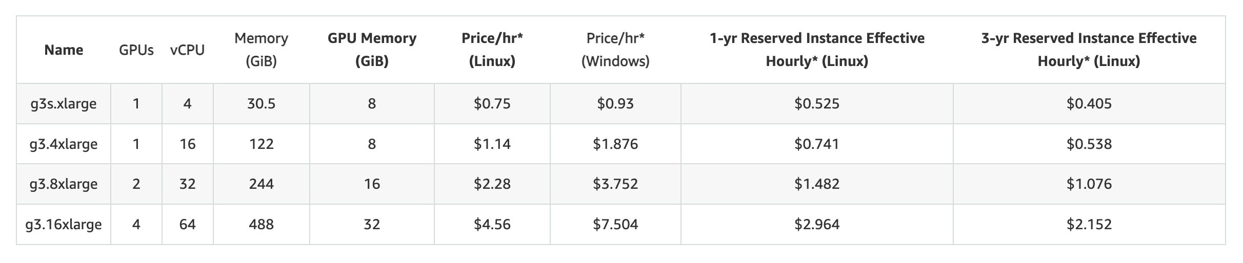
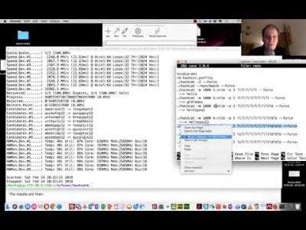
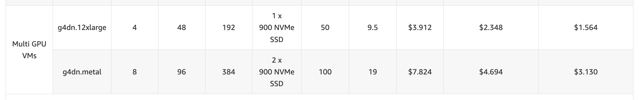
Hashcat – With 8xGPU
Name | Function | Description | Example Rule | Input Word | Output Word
Nothing | : | Do nothing | : | p@ssW0rd | p@ssW0rd
Lowercase | l | Lowercase all letters | l | p@ssW0rd | p@ssw0rd
Uppercase | u | Uppercase all letters | u | p@ssW0rd | P@SSW0RD
Capitalize | c | Capitalize the first letter and lower the rest | c | p@ssW0rd | P@ssw0rd
Append Character | $X | Append character X to end | $1 | p@ssW0rd | p@ssW0rd1
Prepend Character | ^X | Prepend character X to front | ^1 | p@ssW0rd | 1p@ssW0rd
Replace | sXY | Replace all instances of X with Y | ss$ | p@ssW0rd | p@$$W0rd

Slide 69
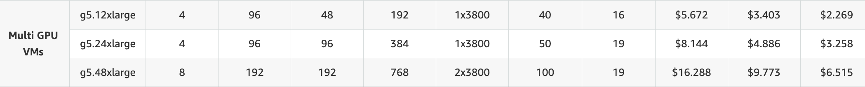
GPUs in the Cloud
G5: NVIDIA A10G Tensor Core GPUs. Up to to 192 vCPUs. 31.2 teraFLOPS, 24GB RAM.
Name | Function | Description | Example Rule | Input Word | Output Word
Nothing | : | Do nothing | : | p@ssW0rd | p@ssW0rd
Lowercase | l | Lowercase all letters | l | p@ssW0rd | p@ssw0rd
Uppercase | u | Uppercase all letters | u | p@ssW0rd | P@SSW0RD
Capitalize | c | Capitalize the first letter and lower the rest | c | p@ssW0rd | P@ssw0rd
Append Character | $X | Append character X to end | $1 | p@ssW0rd | p@ssW0rd1
Prepend Character | ^X | Prepend character X to front | ^1 | p@ssW0rd | 1p@ssW0rd
Replace | sXY | Replace all instances of X with Y | ss$ | p@ssW0rd | p@$$W0rd

Slide 70
Unit 3: Hashing
Hashing Types.
Hashing Methods.
Salting.
Collisions.
LM and NTLM Hashes (Windows).
Hash Benchmarks.
Message Authentication Codes (MACs).
OTP/HOTP.
Hashcat (for practical work)
Prof Bill Buchanan OBE https://asecuritysite.com/hash

